Slide 1
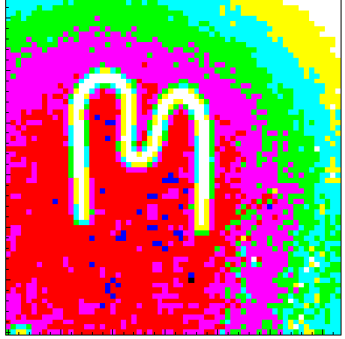
Erik Fröjdh
Hybrid Pixel Detectors
for Radiation Protection
Notes:
----- Meeting Notes (2/25/13 10:17) -----
ESR fellow Ardent project

Slide 2
Outline
Medipix Collaboration
Hybrid pixel detectors
Signal formation
Mixed field response
Ongoing projects
  ATLAS-MPX
  ISS
Demonstration
Summary and Conclusions
Notes:
----- Meeting Notes (2/18/13 16:51) -----
Qestions are welcome during the whole talk

Slide 3
Medipix Collaboration
Two active collaborations, Medipix2 and Medipix3
About 20 members both universities and research institutes.
Large variety of applications, from X-ray imaging to time of flight mass spectrometry and particle tracking.
ASIC design and coordination done at CERN

Slide 4
Development Path
Medipix1
1um SCAMOS 64 by 64 pixels
Photon Counting Demonstrator (1997)
Medipix2
250nm IBM CMOS, 256 by 256 55um pixels
Full photon counting (2002)
Timepix
Analogue (ToT) and Time Stamping (ToA) (2006)
Medipix3RX
130nm IBM CMOS, 256 by 256 55um pixels
Photon Counting, Spectroscopic, Charge Summing, Continuous Readout (2012)
Timepix3
Fast front end, Simultaneous ToT and ToA <20 Mcounts/cm²/s (2013)
SmallPix
Fast front end, Simultaneous ToT and ToA (2013) 0-suppressed
Future LHCb readout – Data driven 40MHz ToT 12Gb/s per chip (2013) ~500 Mcounts/cm²/s
VELOpix
65nm, ~20um pixels
Future Hybrid Pixel Time tagging layer for the LCD project (20??)
CLICPix
4

Slide 5










The Medipix2 Collaboration
Institut de Fisca d'Altes Energies, Barcelona, Spain
University of Cagliari and INFN Section thereof, Italy
CEA, Paris, France
CERN, Geneva, Switzerland,
Universitat Freiburg, Freiburg, Germany,
University of Glasgow, Scotland, UK
Universita' di Napoli and INFN Section thereof, Italy
NIKHEF, Amsterdam, The Netherlands
University of Pisa and INFN Section thereof, Italy
Laboratory of Molecular Biology, Cambridge, England, UK
Mid Sweden University Sundsvall, Sweden,
Czech Technical University, Prague, Czech Republic
ESRF, Grenoble, France
Academy of Sciences of the Czech Republic, Prague
Universität Erlangen-Nurnberg, Erlangen, Germany
University of California, Berkeley, USA
University of Houston, Texas, USA

Slide 6
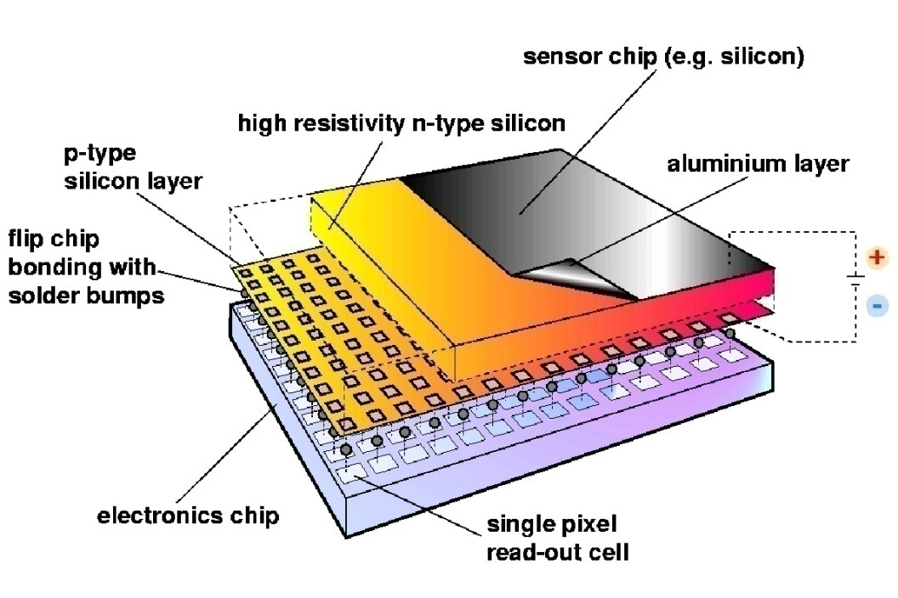
Hybrid Pixel Detectors

Slide 7
Hybrid Pixel Detectors

Slide 8
Timepix
Hybrid Pixel Detector
256x256 pixels
55um pixel pitch
Single Photon Processing
  Time-over-Threshold
  Time of arrival
  Photon Counting
Capable of operating in
both electron and hole
collection mode
~ 500 transistors / pixel

Slide 9
Benefits of Single Photon Processing
Each sensor pixel has its own dedicated readout circuit
That circuit is sensitive only to the tiny electrical pulses generated by ionizing radiation in the sensor and not to other background noise
Because of this hybrid pixels deliver clean noise-free images
M. Campbell

Slide 10
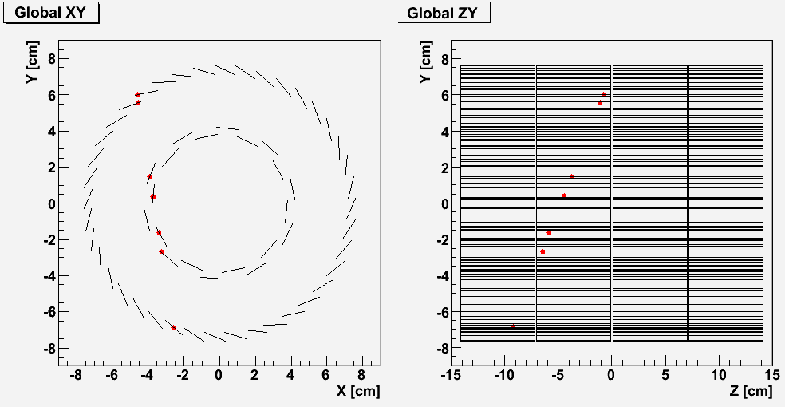
Cosmic Particles in the Alice Experiment

Slide 11
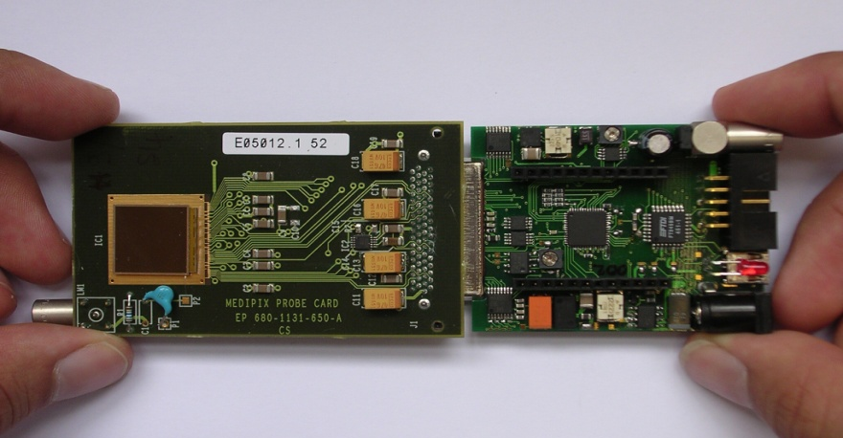
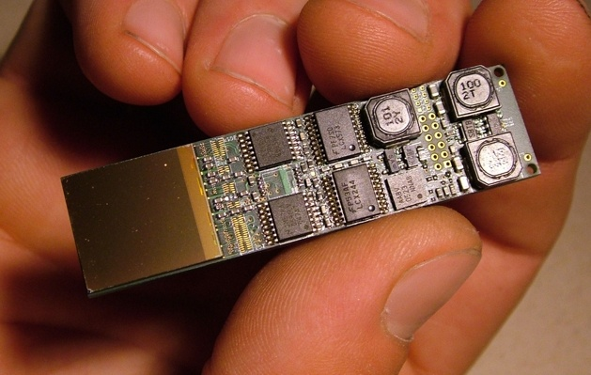
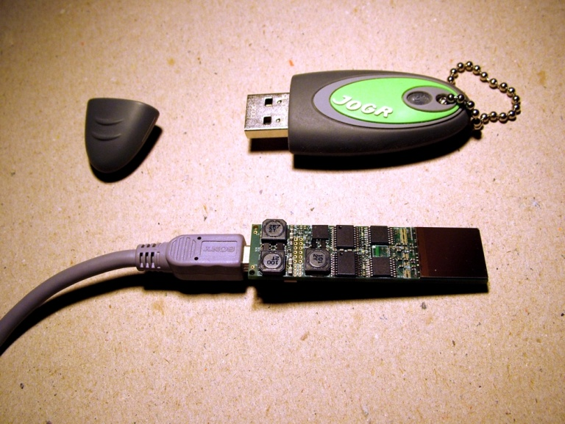

Timepix
Compact system 15x60mm for the USB Lite read out including sensor
USB Connection to standard PC
Pixelman control software allowing scripting and plugins
Usb read out
Usb lite
Pictures courtesy of IEAP Prague
Usb lite

Slide 12
Signal Formation
Moving charge induces a signal on the read out pad
Pulse height is proportional to the deposited energy
In order to detect a particle it has to interact with the sensor material and create electron-hole pairs
amplitude
TH
time

Slide 13
Charge carrier simulation CdTe
By David Krapohl, Mid Sweden University

Slide 14
Basic Particle Identification
Mixed radiation fields poses problems for dosimetric measurements.
An advantage of a pixelated detectors is that particles can be identified by their track shape.
This is based on the different ways the particles interact in the sensor.

Slide 15
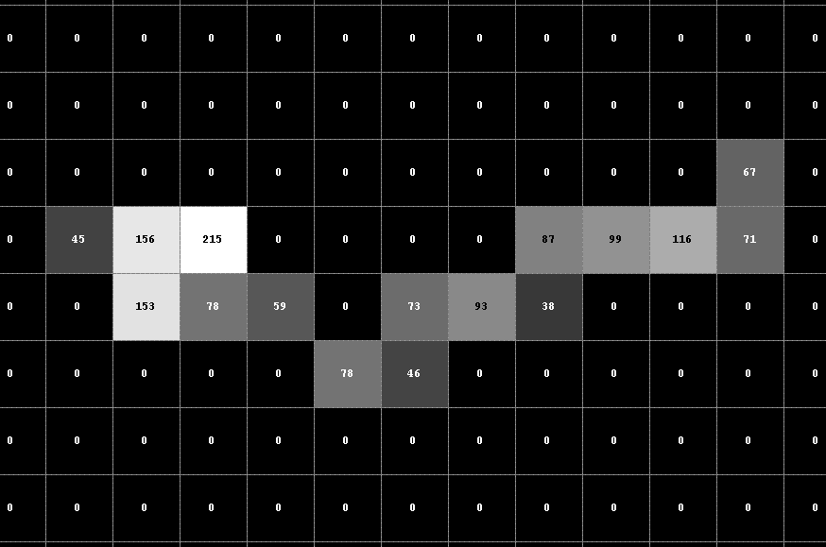
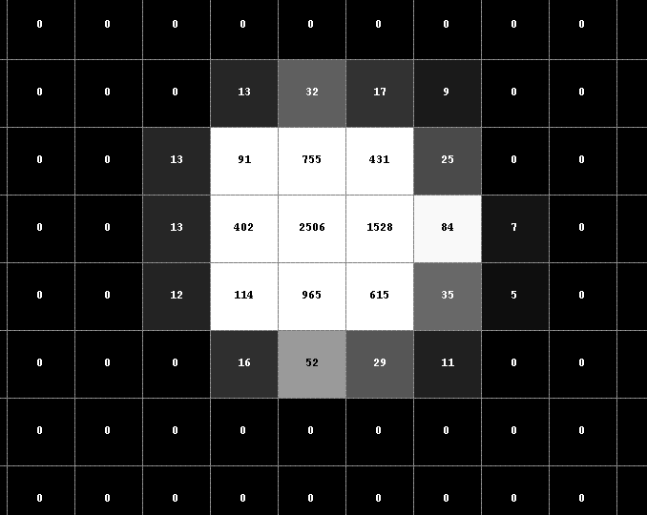
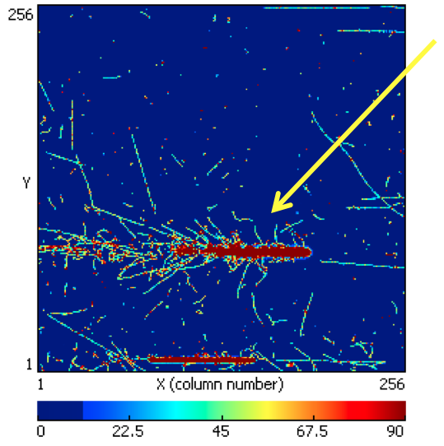
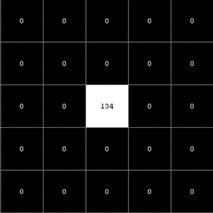
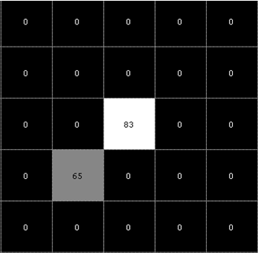
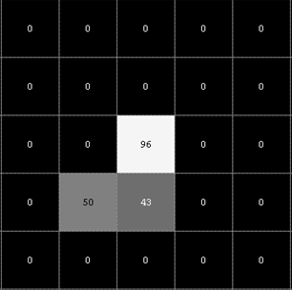
Basic Particle Identification
0.5MeV Electron (⁹⁰Sr)
5.5MeV Alpha (²⁴¹Am)
Pb ion with delta rays
Erik Heijne [2]
60keV Photons (²⁴¹Am)

Slide 16
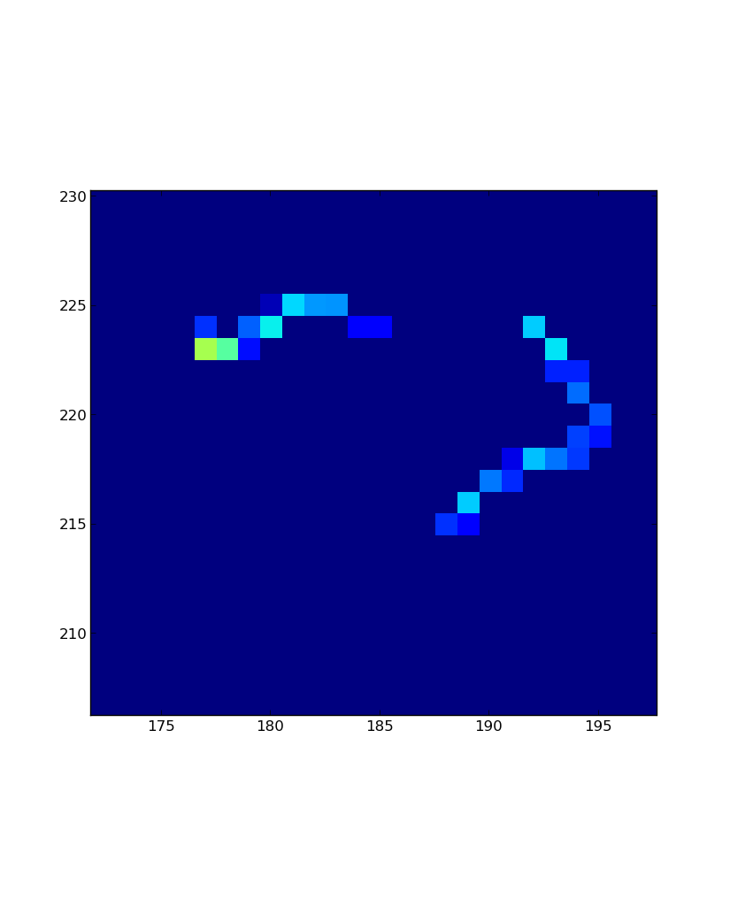
Basic Particle Identification
Possible to categorize particles using track and energy information
Some types of particles are hard or impossible to separate
Additional convertors and filters improve the detection specificity
β⁻ radiation or
Compton electrons?

Slide 17
Neutron Detection
Neutron have no charge and are therefore not directly detectable by Coulomb interactions in the sensor.
Thermal neutrons are detected by the production of secondary radiation by neutron capture in a convertor layer
Ex. n + 6Li → α (2.05 MeV) + 3H (2.73 MeV)
Fast neutrons can be detected by elastic scattering in the sensor layer but for increased efficiency and specificity a hydrogen rich converter material as Poly ethylene is used.

Slide 18
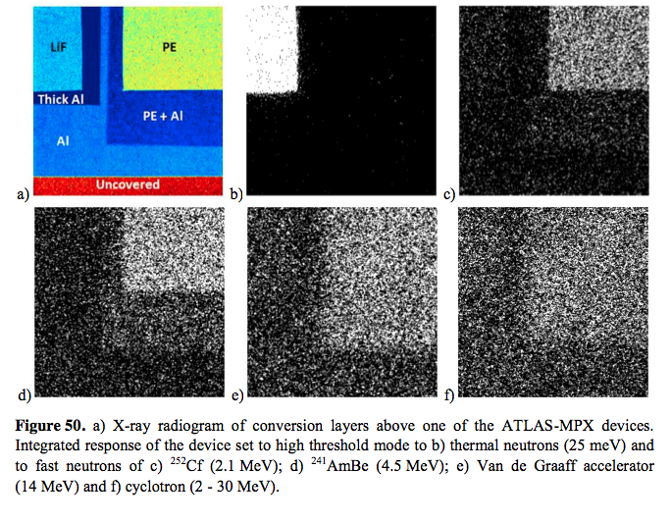
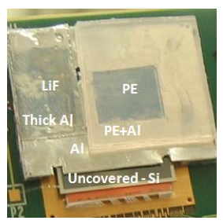
Neutron Detection
Medipix2MXR with different
convertors.
Work done by Z. Vykydal [1]

Slide 19
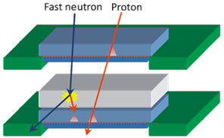
Improved Neutron Detection
To separate heavy charged particles form neutron response test have been made with a multi layer detector.
Interactions registered in both layers
  Low LET signatures – minimum ionizing charge particles (muons, energetic electrons,...)
  High LET signatures – highly ionizing charged particles (~10 MeV protons,...)
Interactions registered in single layer only
  Low LET signatures – photon interactions in one of the sensitive layers
  High LET signatures – fast neutron interactions in polyethylene region or thermal neutron interactions in 6Li region
Example of particle identification using a two layer detector
Work done by Z. Vykydal [1]

Slide 20
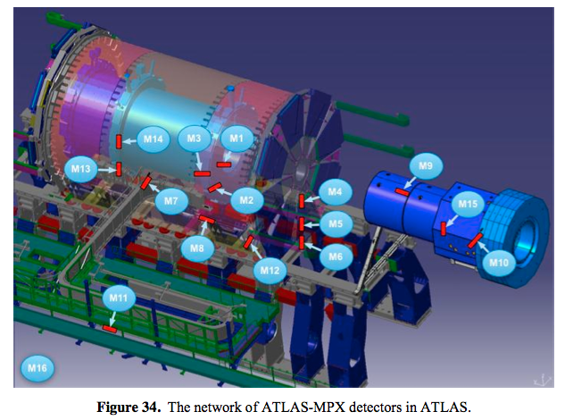
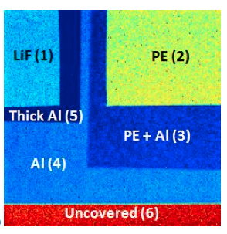
ATLAS-MPX Network
16 Medipix2MXR detectors with neutron convertors
Placed in the ATLAS experimental cavern
Installed in 2008 before the first LHC beam
Proposed upgrade to Timepix detectors
Work done by Z. Vykydal [1]

Slide 21
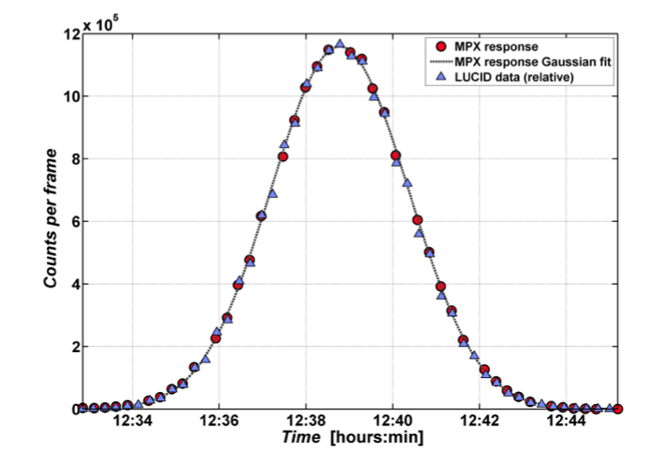
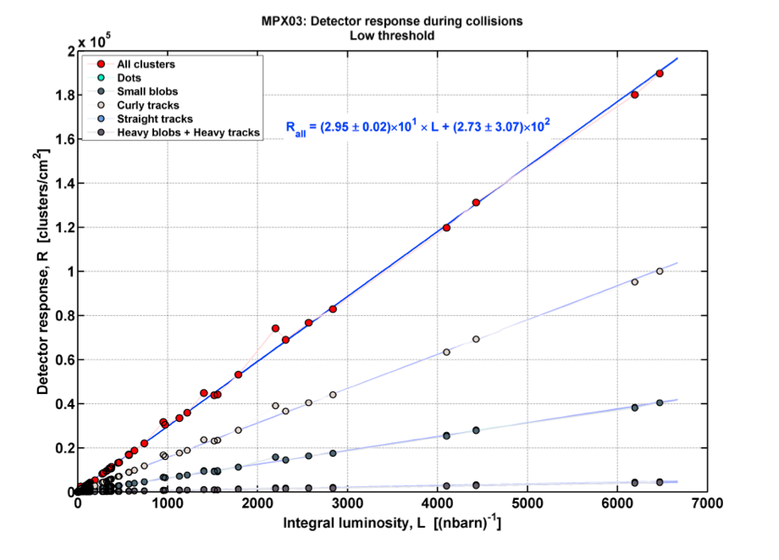
ATLAS-MPX
Good agreement with beam luminosity and other instruments
Work done by Z. Vykydal [1]

Slide 22
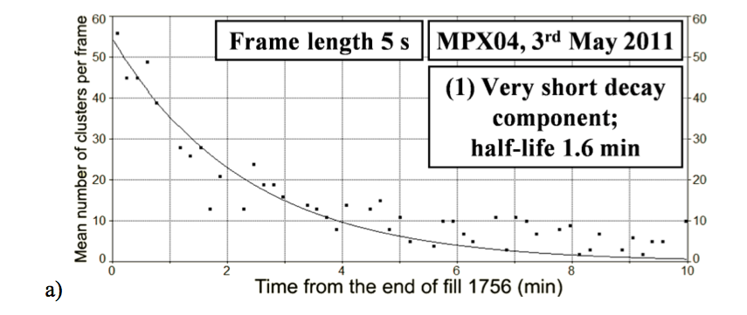
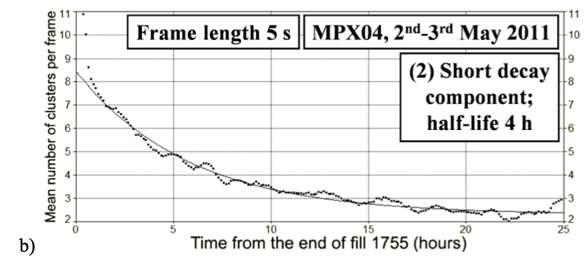
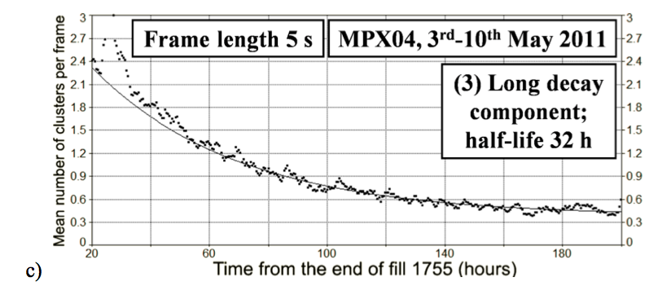
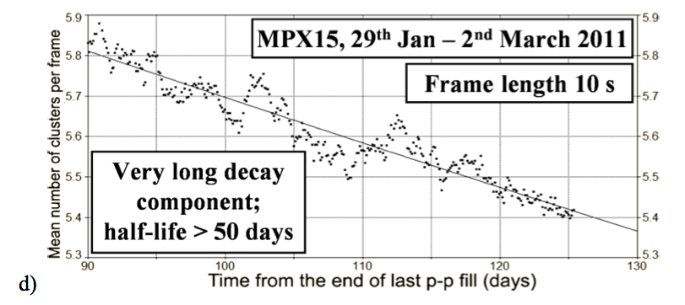
Radioactive Activation
Work done by Z. Vykydal [1]

Slide 23

Timepix Detectors at ISS
5 Timepix Usb Lite detectors with 300um Si sensors are currently in operation at the ISS
Evaluated as an option for radiation field monitors and personal dosimeters
Mixed radiation field
Important to get the right quality
factor for heavy ions

Slide 24
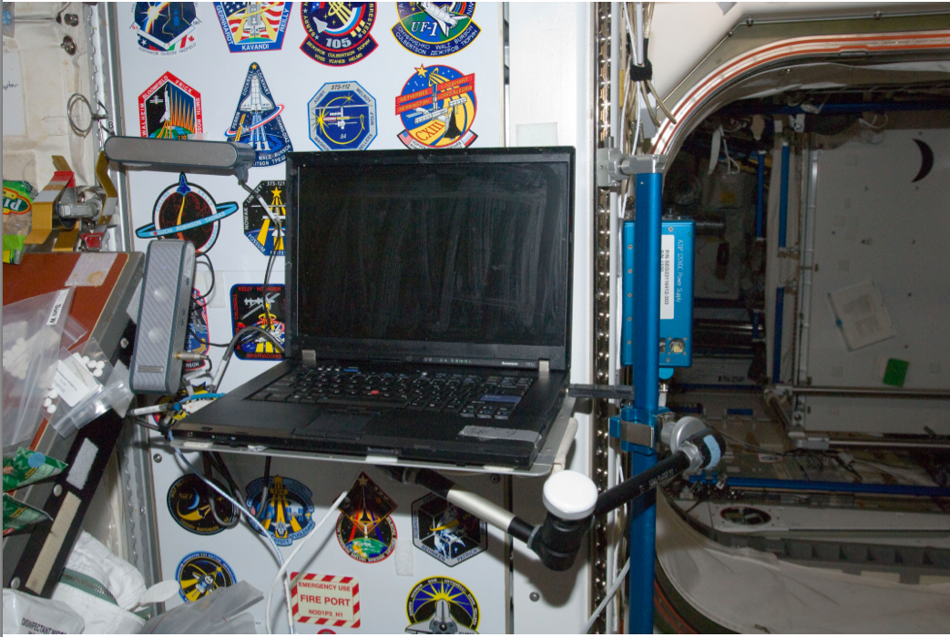
Timepix Detectors at ISS

Slide 25
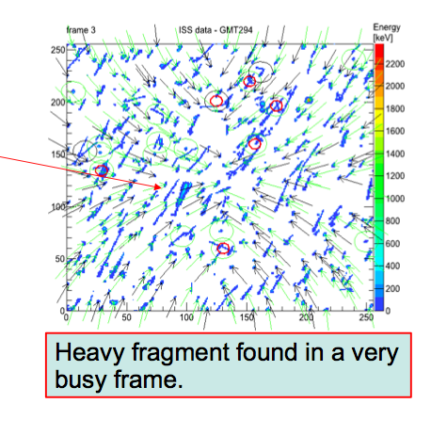
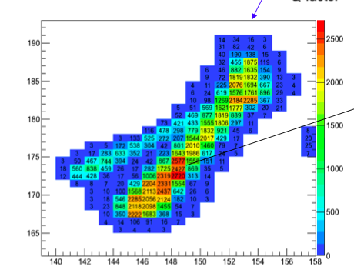
Timepix Detectors at ISS
Heavy Ion fragment, Q factor ~ 25

Slide 26
Demonstration

Slide 27
Why use Hybrid Pixel Detectors for Mixed Field Radiation Measurements?
The chip is sensitive only to the tiny electrical pulses generated by ionizing radiation in the sensor and not to background noise
No background noise and multiple channels gives a high dynamic range (more then 9 orders of magnitude)
Energy information, track shape, different convertors and provides a high specificity in a mixed field
Flexible system, the use different sensor materials, filters, converters and stacking to tailor to a specific radiation field.

Slide 28
Referenses
[1] Vykydal Z., Evaluation of Radiation Field Properties with Pixel Semiconductor Detectors Operating in Particle Tracking Mode, PhD. Thesis, Albert-Ludwigs-Universität Freiburg, 2012
[2] Heijne E., Measurements and possible identification of secondary GeV ions in the SPS H8 beam during the January 2013 LHC lead run, Presentation at the Medipix Meeting 30 January 2013

Slide 29
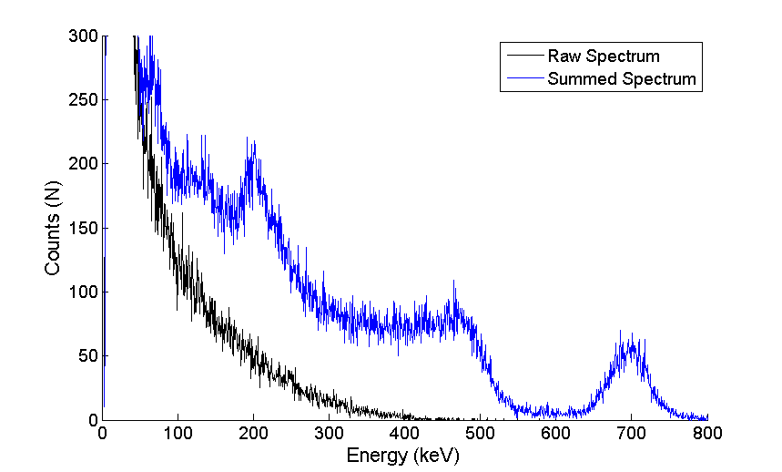
Cluster Summing
662keV

