Slide 1
Studies on Activation in the ATLAS cavern with MPX Detectors
PRELIMINARY
Benedikt Bergmann
Institute of Experimental and Applied Physics, Czech Technical University in Prague, Czech Republic
On behalf of the ATLAS MPX detector group
Nedaa Asbah² , Petr Beneš¹ ,Bartoloměj Biskup¹,
Jan Jakůbek¹, Claude Leroy², Stanislav Pospíšil¹,
Jaroslav Šolc¹, André Sopczak¹, Vít Sopko¹,
Paul Soueid², Michal Suk¹, Daniel Tureček¹,
Zdeněk Vykydal¹
¹ IEAP CTU Prague, Czech Republic — ² Université de Montréal, Canada
Dresden 07/03/2013

Slide 2
Overview
The ATLAS MPX-detector network
Method of studying the activation (example MPX01)
Overview over results for different detectors
Summary

Slide 3
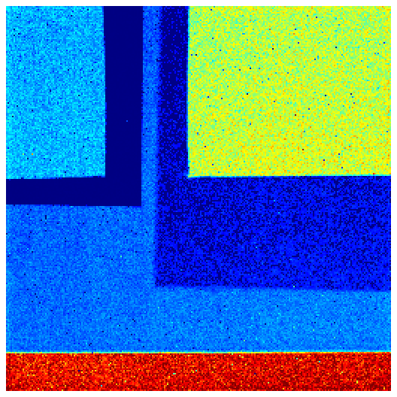
The ATLAS MPX detector network – Devices
Medipix 2 ASIC with 300µm Silicon layer
256 x 256 pixel
Pixel pitch 55 µm
Converter foils:
⁶Li(n,α)³H: thermal neutrons
recoiled protons below PE: fast neutrons
LiF
PE
PE + Al
Al
Uncovered

Slide 4
The ATLAS MPX detector network – detected particle types
Efficiencies (for noncharged particles reduced by the conversion efficiency to detectable charged particles and geometry factors):
Charged particles (above 8 keV): 100%
X-rays (10 keV): ~80%
Gamma-rays (above 1 MeV): ~0.1%
Thermal neutrons (energy < 0.5 eV): ~1%
Fast neutrons (MeV range): ~0.1%
Device lifetime:
Expected to withstand up to 10¹³ n/cm²
Before installation: tested up to 1.5x10¹² n/cm²
Current integral number of high energy transfer particles (HETP) impinging on MPX01: 2x10¹⁰ HETP/cm²

Slide 5
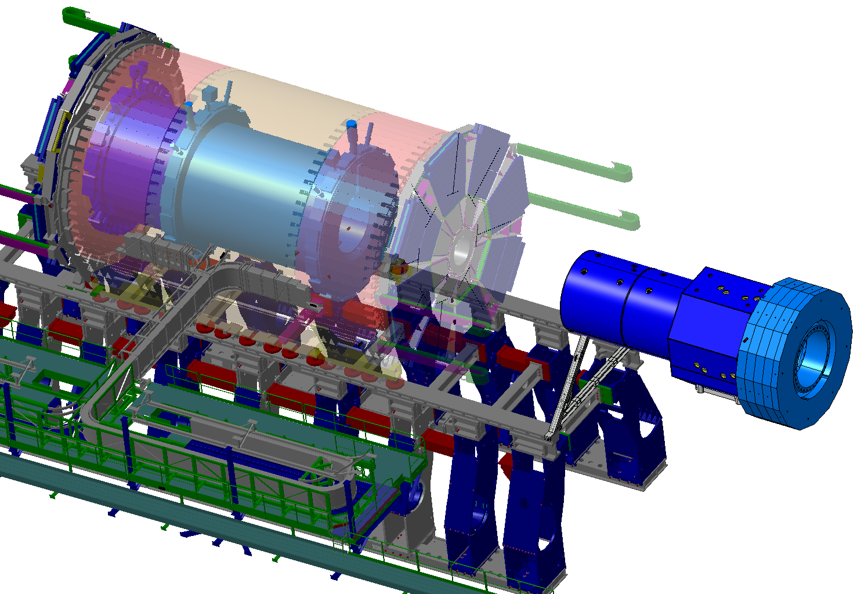
The ATLAS MPX detector network – MPX positions
Detector | X [m] | Y [m] | Z [m] | R [m]
MPX01 | -0.71 | 0.29 | 3.42 | 0.77
MPX02 | -2.23 | -1.12 | 3.42 | 2.50
MPX03 | -3.45 | -0.93 | 2.94 | 3.57
MPX13 | -2.21 | -1.02 | -3.42 | 2.44
M14
M1
M7
M3
M13
M9
M4
M2
M5
M8
M6
M12
M15
M10
M11
Side A
Notes:
Coordinates with respect to the beam line!

Slide 6
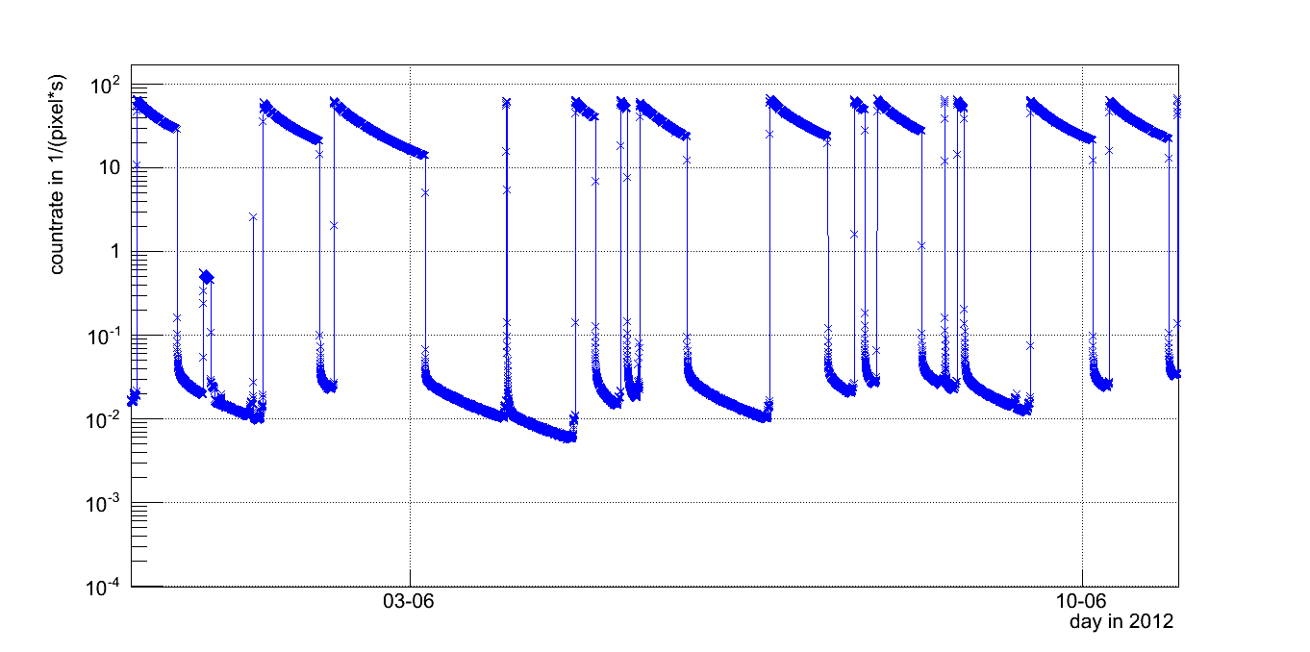
Count rate at MPX01 site during and after collisions
Activation of surrounding material during collisions in the ATLAS detector
Luminosity monitoring with MPX devices: Background contribution
Dosimetric aspect: What is the time dependency of the ambient dose equivalent rate after the collisions?
pp-collision region
Notes:
Collision period after collision period! Zoom into collision period then this plot and zoom ohter region!

Slide 7
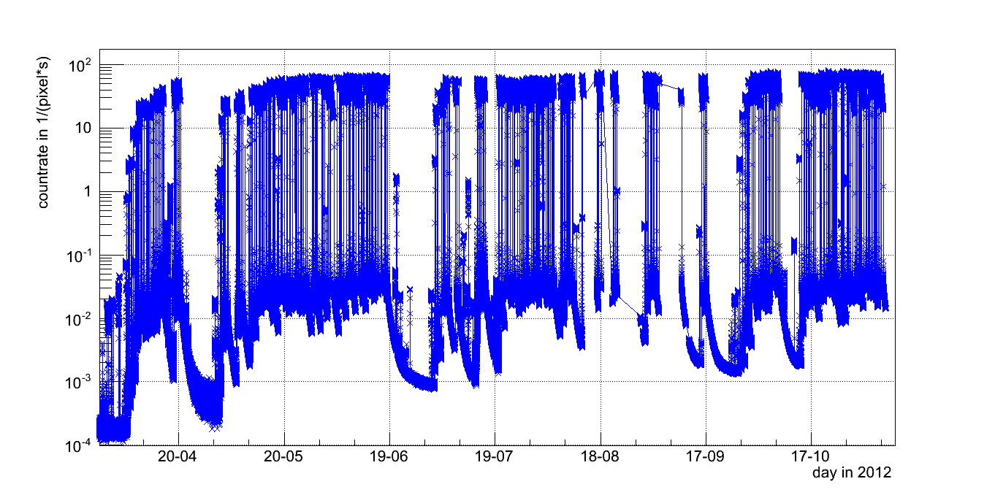
Count rates of the whole inves-tigated period (March – Dec 2012)
Especially to determine the components with long half lifes it is necessary to use as long period as possible

Slide 8
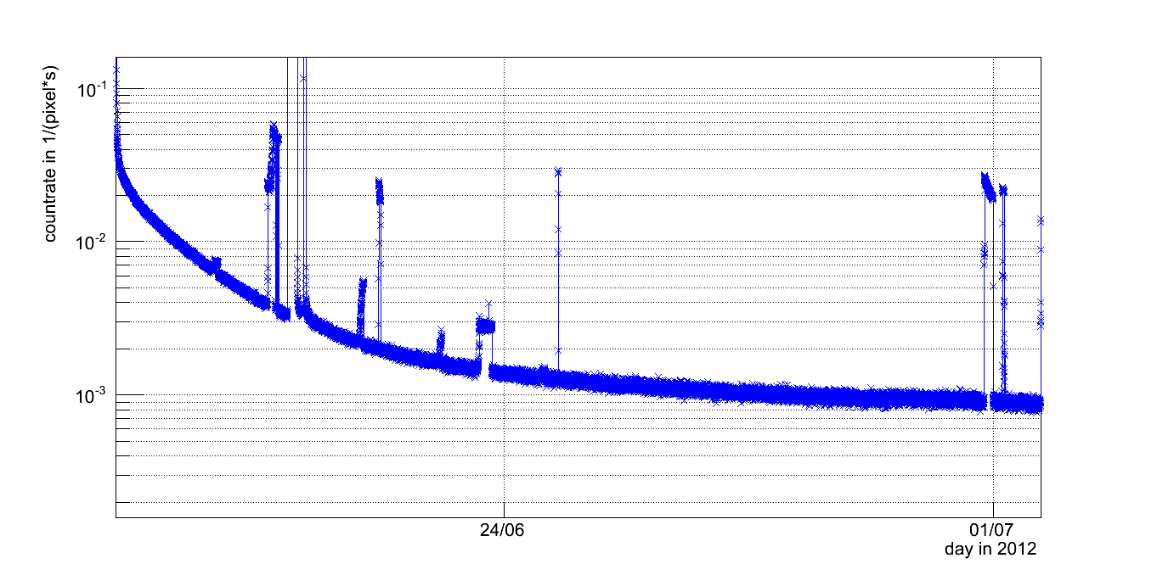
Count rates at MPX01 site: decay period

Slide 9
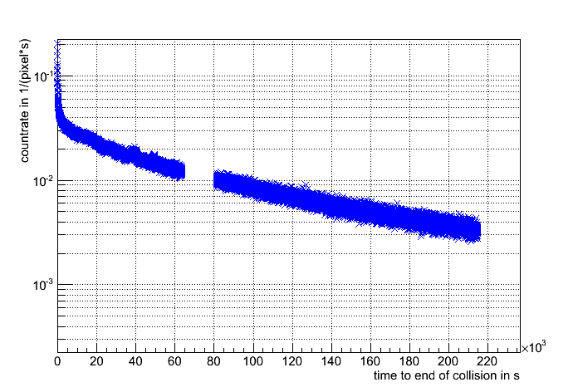
Describing the decay of activated products
Sum of radioactive decays of n isotopes:
Fit of sum of exponetial is an ill-conditioned problem
$$f\left(t\right)=\sum_{i=1}^{n}{k_{i}∙e^{− \frac{\ln\left(2\right)}{T_{\frac{1}{2}}^{i}} ∙ t}}$$
Choose appropriate region without collisions (exclude collisions)
Fit sum of two exponential decays
Subtract faster decay component from data
Repeat steps 2. and 3. until all data is fitted
Notes:
Low luminuosity run excluded!

Slide 10
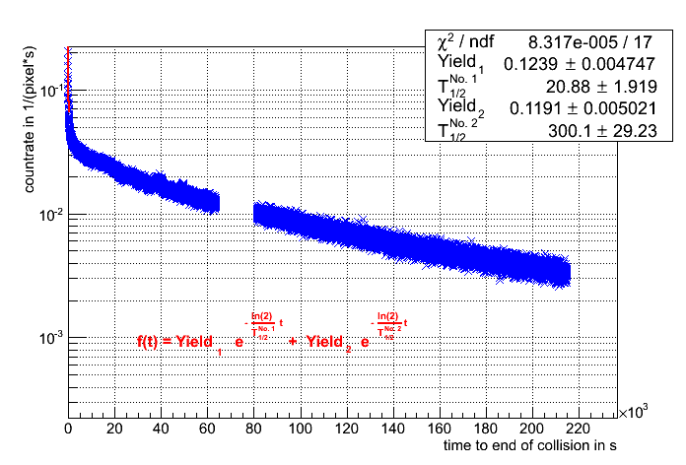
Describing the decay of activated products
Sum of radioactive decays of n isotopes:
Fit of sum of exponetial is an ill-conditioned problem
$$f\left(t\right)=\sum_{i=1}^{n}{k_{i}∙e^{− \frac{\ln\left(2\right)}{T_{\frac{1}{2}}^{i}} ∙ t}}$$
Choose appropriate region without collisions (exclude collisions)
Fit sum of two exponential decays (with range 0 to estimated half life times 10)
Subtract faster decay component from data
Repeat steps 2. and 3. until all data is fitted

Slide 11
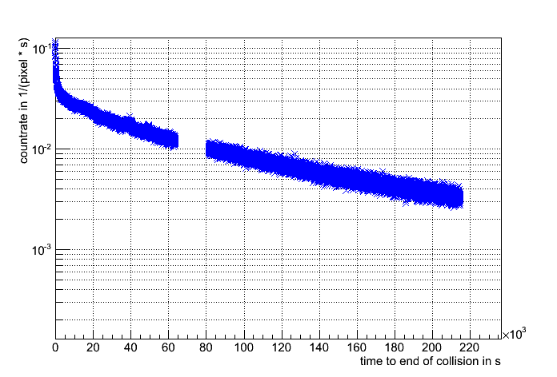
Describing the decay of activated products
Sum of radioactive decays of n isotopes:
Fit of sum of exponetial is an ill-conditioned problem
$$f\left(t\right)=\sum_{i=1}^{n}{k_{i}∙e^{− \frac{\ln\left(2\right)}{T_{\frac{1}{2}}^{i}} ∙ t}}$$
Choose appropriate region without collisions (exclude collisions)
Fit sum of two exponential decays (with range estimated half life times 10)
Subtract faster decay component from data
Repeat steps 2. and 3. until all data is fitted

Slide 12
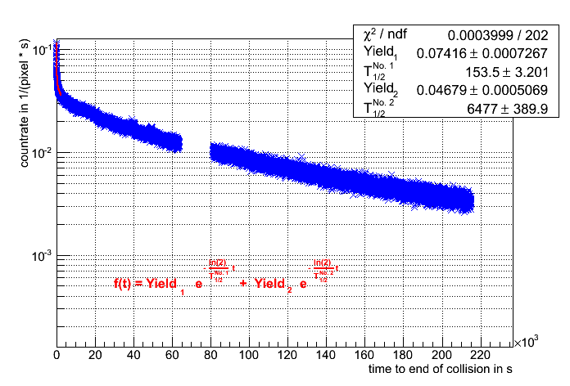
Describing the decay of activated products
Sum of radioactive decays of n isotopes:
Fit of sum of exponetial is an ill-conditioned problem
$$f\left(t\right)=\sum_{i=1}^{n}{k_{i}∙e^{− \frac{\ln\left(2\right)}{T_{\frac{1}{2}}^{i}} ∙ t}}$$
Choose appropriate region without collisions (exclude collisions)
Fit sum of two exponential decays (with range estimated half life times 10)
Subtract faster decay component from data
Repeat steps 2. and 3. until all data is fitted

Slide 13
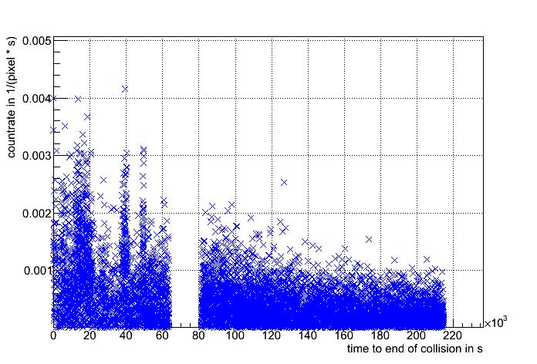
Describing the decay of activated products
Sum of radioactive decays of n isotopes:
Fit of sum of exponetial is an ill-conditioned problem
$$f\left(t\right)=\sum_{i=1}^{n}{k_{i}∙e^{− \frac{\ln\left(2\right)}{T_{\frac{1}{2}}^{i}} ∙ t}}$$
Choose appropriate region without collisions (exclude collisions)
Fit sum of two exponential decays (with range estimated half life times 10)
Subtract faster decay component from data
Repeat steps 2. and 3. until all data is fitted

Slide 14
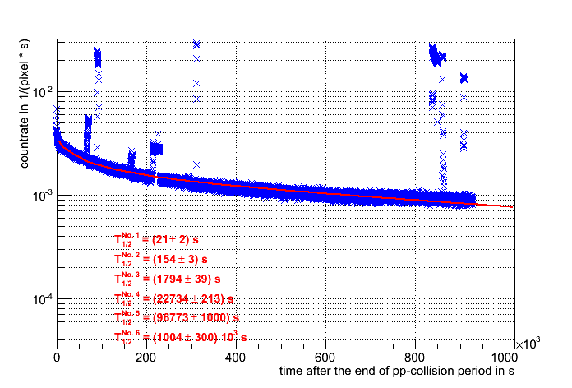
Modelling one decay region with the fitted half lifes
components with longer half life present (have to be guessed for the further analysis)
Notes:
Time to end -> time after collisions

Slide 15
Equation to describe the whole set of data
$$M_{act}^{i}= \sum_{k=1}^{n}{M_{act}^{i−1,k}×e^{−λ_{k}t}}+\left(M_{tot}^{i}−M_{act}^{i−1}\right)× \text{θ}\left(M_{tot}^{i}−M_{act}^{i−1}\right)×\sum_{k=1}^{n}{Y_{k}×\left(1−e^{−λ_{k}t}\right)}$$
Decay of atoms activated before i-th frame
Activation during i-th frame (valid only during collisions)
M_{tot} total count rate measured in the given MPX frame (normalized to unit time)
M_{act} count rate caused by all activation products created until the end of the given (i-th) MPX frame
λ decay constant, λ = ln(2)/T_{1/2}; T_{1/2} is the half-life
t time period between the end of (i-1)-th frame and the end of i-th frame
Y_{k} normalization constant, used to fit the growth/decay curve to the measured data
Deduced by Jaroslav Solc according laws of nuclear growth and decay
Notes:
Define w_k; k_ and w_k determined from measurement

Slide 16
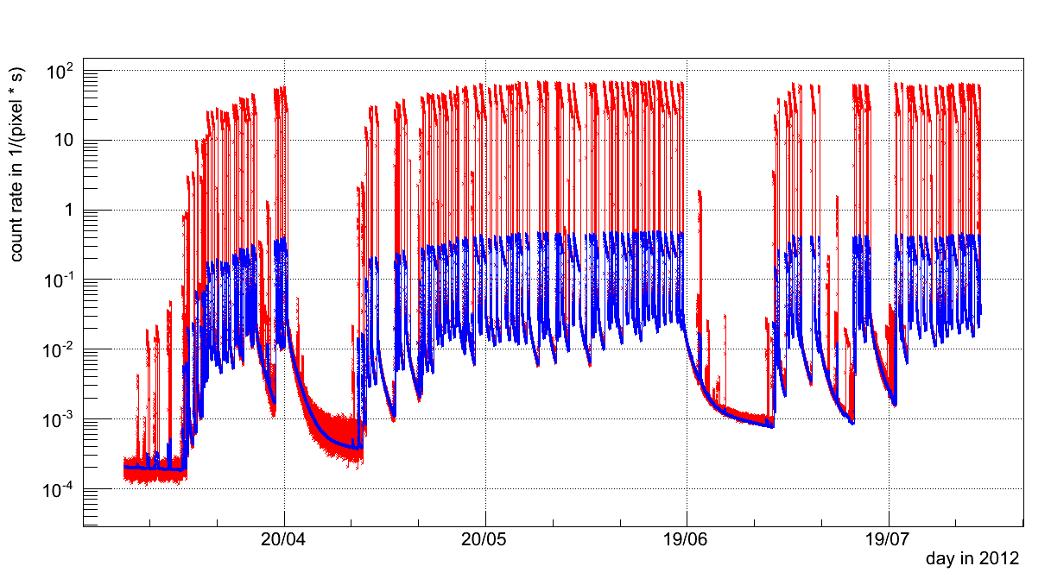
Fitting the formula to the data
Adapting half lifes from the fit and adding longer components
Guessing the yields
Measured count rates
Estimated activation count rate

Slide 17
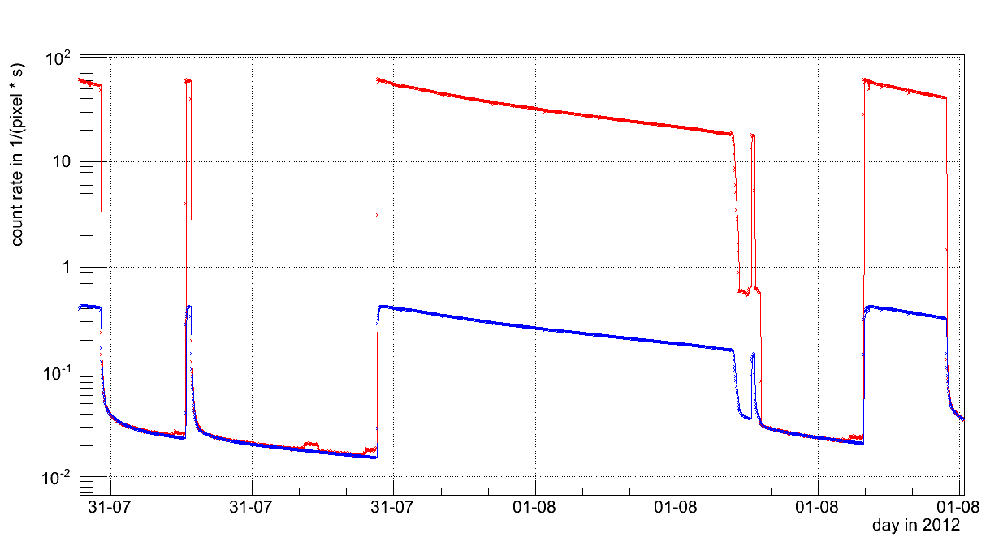
Activation – MPX01 (example 1)
Measured count rates
Estimated activation count rate
Notes:
Beam effects before collisions and unsuccessful fill!
Beam alignment problems and abort of fill!

Slide 18
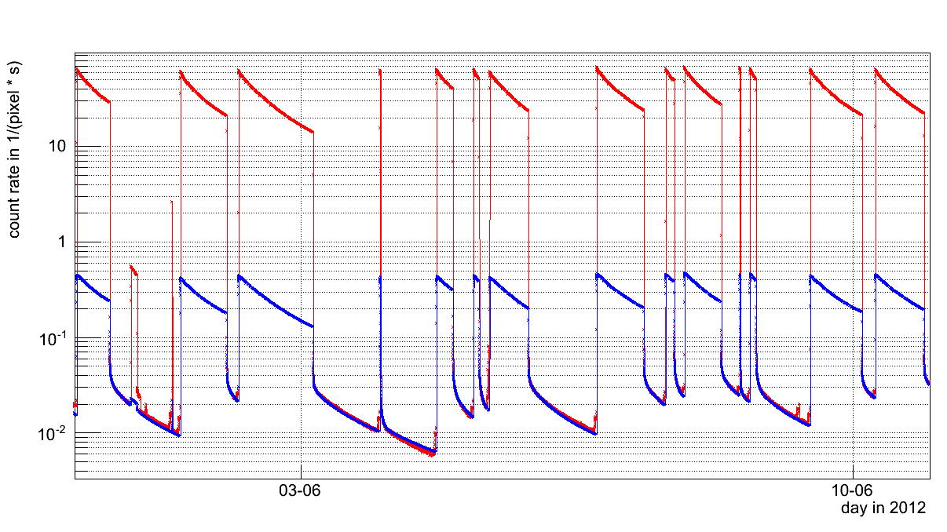
Activation – MPX01 (example 2)
Measured count rates
Estimated activation count rate
Notes:
Beam effects before collisions and unsuccessful fill!
Beam alignment problems and abort of fill!

Slide 19
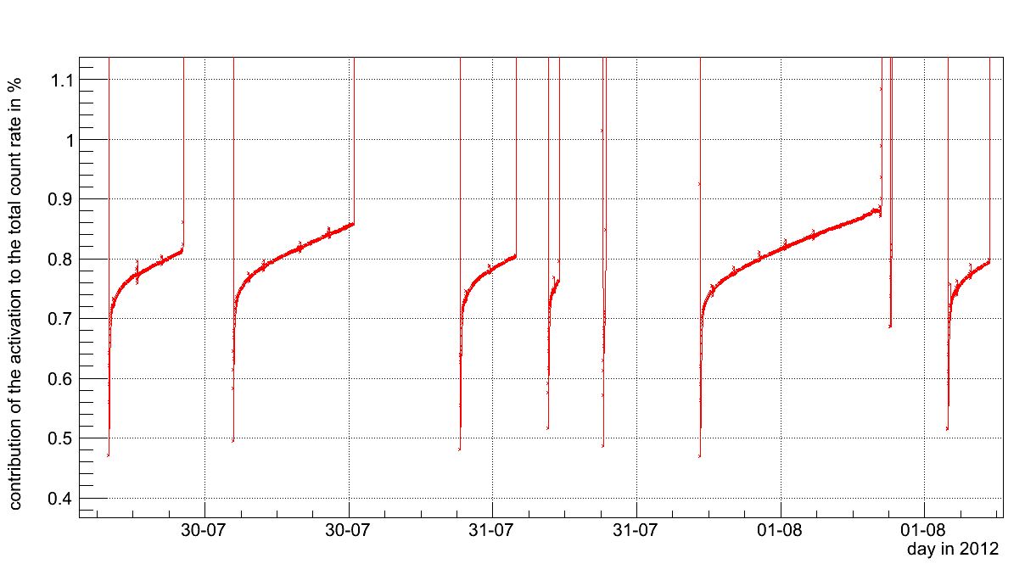
Activation contribution to total count rate during collisions (MPX01)
Notes:
Peaks -> Frames bigger gap? Resetting

Slide 20
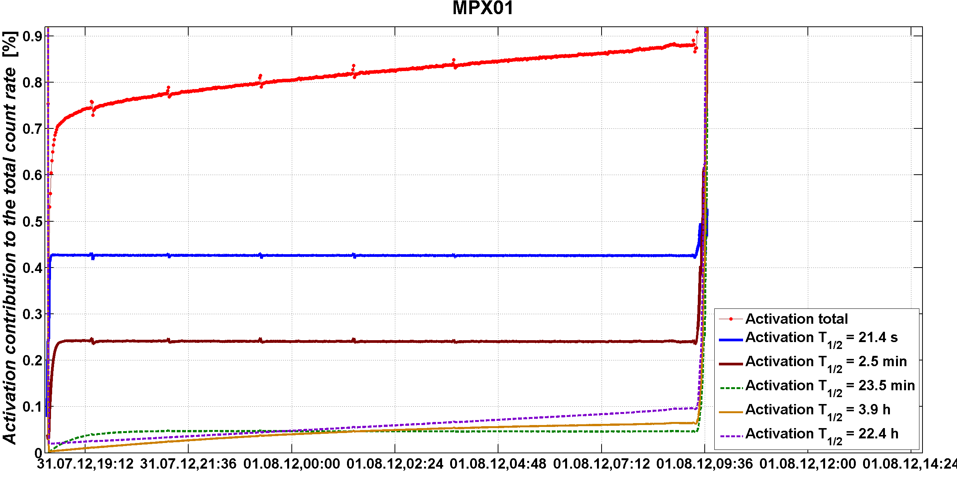
Activation contribution to total count rate during collisions (detail)
Notes:
Peaks -> Frames bigger gap? Resetting

Slide 21
Overview – Half lifes and yields
Activation component | 1 | 2 | 3 | 4 | 5 | 6 | 7 | 8
Half-life | 21.4 s | 2.7 min | 24 min | 3.9 h | 20 h | 7 d | 104 d | 350 d
Yield | 4.292E-03 | 2.413E-03 | 4.491E-04 | 4.860E-04 | 8.298E-04 | 6.472E-05 | 6.472E-05 | 0.000E+00
MPX01
Activation component | 1 | 2 | 3 | 4 | 5 | 6 | 7 | 8
Half-life | 21.4 s | 2.7 min | 24 min | 3.9 h | 21 h | 7 d | 32 d | 350 d
Yield | 3.816E-02 | 1.373E-02 | 2.396E-03 | 3.623E-03 | 2.667E-03 | 4.025E-04 | 1.421E-04 | 9.471E-05
MPX02
Activation component | 1 | 2 | 3 | 4 | 5 | 6 | 7 | 8
Half-life | 21.4 s | 2.7 min | 24 min | 3.9 h | 22 h | 7 d | 32 d | 350 d
Yield | 3.816E-02 | 1.318E-02 | 2.941E-03 | 3.410E-03 | 4.091E-03 | 7.103E-04 | 3.315E-04 | 9.471E-05
MPX03
MPX13
Activation component | 1 | 2 | 3 | 4 | 5 | 6 | 7 | 8
Half-life | 21.4 s | 2.7 min | 24 min | 3.5 h | 19 h | 7 d | 111 d | 350 d
Yield | 3.816E-02 | 1.785E-02 | 2.832E-03 | 5.114E-03 | 3.576E-03 | 5.327E-04 | 1.894E-04 | 9.471E-05
Notes:
Data from the fit of MPX01 is also used as a starting point of the evaluation of the other detectors. The actual fit is done manually and similar half lifes were foud at the posotions of the different devices.
Sn = tin
Zn = zinc

Slide 22
Summary
A method was described to estimate the count rates of activated products during and after collisions
Estimate the background due to activation for the luminosity analysis
To predict time dependence of count rates after the beam is off (using known conversion factors the ambient dose equivalent rate can be obtained)
Procedure was done for MPX01, MPX02, MPX03, MPX13 within the ATLAS-MPX detector network
Similar half lifes were obtaines for all detectors

Slide 23
Thank you for your attention!

