Slide 1

THE ARDENT PROJECT AND MEDIPIX
Medipix Meeting, Nov 28th 2012

Slide 2













ARDENT
February 2012 – January 2016
Advanced Radiation Dosimetry European Network Training initiative
Marie Curie Initial Training Network under EU FP7 – 4 M€
7 (8) Full Partners and 5 Associate Partners
Coordinator: CERN, Scientist-in-Charge: Dr. M. Silari
CERN (coordinator), Switzerland
AIT Vienna, Austria / Siebersdorf Laboratories
CTU- IAEP Prague, Czech Republic
IBA Dosimetry, Schwarzenbruck, Germany
Jablotron, Prague, Czech Republic
MI.AM, Milano, Italy
Politecnico, of Milano, Italy
ST Microelectronics, Italy
University of Erlangen, Germany
University of Houston, USA
University of Ontario, Canada
University of Wollongong, Australia

Slide 3
Development of advanced instrumentation for radiation monitoring…
Three main technologies
Gas detectors [e.g., gas electron multipliers (GEM), tissue equivalent proportional counters (TEPC)]
Solid state detectors [e.g., Medipix, silicon micro-dosimeters]
Track detector techniques [e.g., CR-39, nano-dosimeters]
We can still add detectors / technologies we think are worth investigating!

Slide 4
Objectives & Applications
Main objectives
  Radiation dosimetry
  Micro- and nano-dosimetry
  Photon and neutron spectrometry
Applications
  Characterization of radiation fields at particle accelerators (research, industry, medical)
  Characterization of radiation fields on-board aircrafts and in space
  Assessment of secondary dose to RT patient
  Measurement of properties of clinical hadron beams

Slide 5
Researcher Recruitment
15 Early Stage Researchers (ESR), 9 already recruited
  4 at CERN: Eleni Aza (Gr), Erik Fröjdh (SE), Stuart George (GB), Silvia Puddu (It)
  2 ait AIT / SL, Vienna: Andrej Sipaj (Sl)
  3 at CTU, Prague: Benedikt Bergmann (DE), Kevin Loo (AU)
  2 at IBA Dosimetry, Schwarzenbruck
  1 at Jablotron, Prague: Vijayaragavan Viswanathan (India)
  1 at MI.AM, Milano: Alvin Sashala Naik (Mauritius)
  2 at the Politecnico, Milano: Chris Cassell (AU), Eleni Sagia (Gr)
Up to 1/3 of time can be spent on secondments
Work performed within the project to be used for PhD
Generous training allowance for researchers

Slide 6
Work Packages
Seven Work Packages
  WP1: gas detectors (Sofia Rollet, AIT, Vienna)
  WP2: solid state detectors (Zdenek Vykydal, CTU, Prague)
  WP3: track detectors (Marco Caresana, Politecnico, Milano)
  WP4: instrument inter-comparison (Matteo Magistris, CERN)
  WP5: training
    Individual training programs
    Network-wide training
  WP6: dissemination and outreach
  WP7: ITN management

Slide 7
ARDENT Structure
Supervisory Board (SB)
Administrative support unit (CERN)
ITN Management Office
Scientist in Charge
Selection Committees
Technical Training Board
(Leaders WP 1-4)
Training Board
(WP 5)
Dissemination and Outreach Board (WP 6)
http://cern.ch/ardent

Slide 8
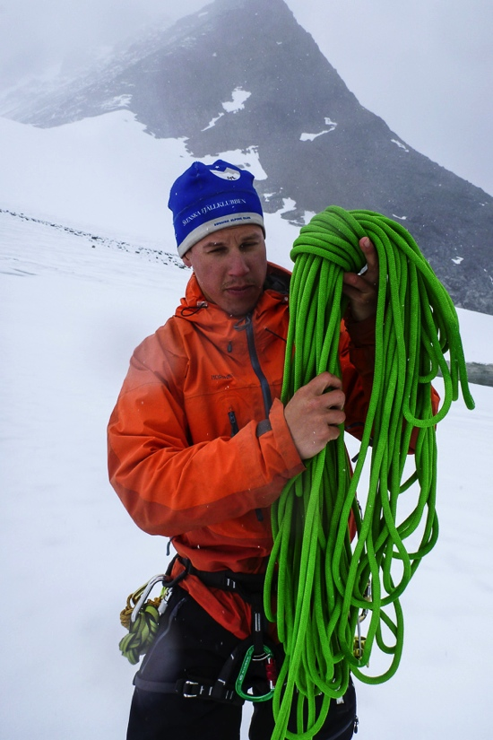
ERIK FRÖJDH – ESR 2
28 Years old
Born in Sundsvall, Sweden
Education
  Master of Science degree in Physics from
  Mid Sweden University jan 2010
  Admitted as a PhD student at
  Mid Sweden University ( feb 2010 )
Previous work
  Characterization of silicon sensors produced
  at Mid Sweden University
  Evaluation of x-ray techniques for measurements
  of paper coating compositions
  Characterization of CdTe sensors
  Investigation of excessive noise in Timepix ToT mode
Work within ardent
  Application of Timepix as a dosimeter in space and around accelerators
  Characterization of Medipix3RX and Timepix 3
  Medipix support for the other ESRs

Slide 9
Noise in timepix tot spectrum

Slide 10
Noise in timepix tot spectrum

Slide 11
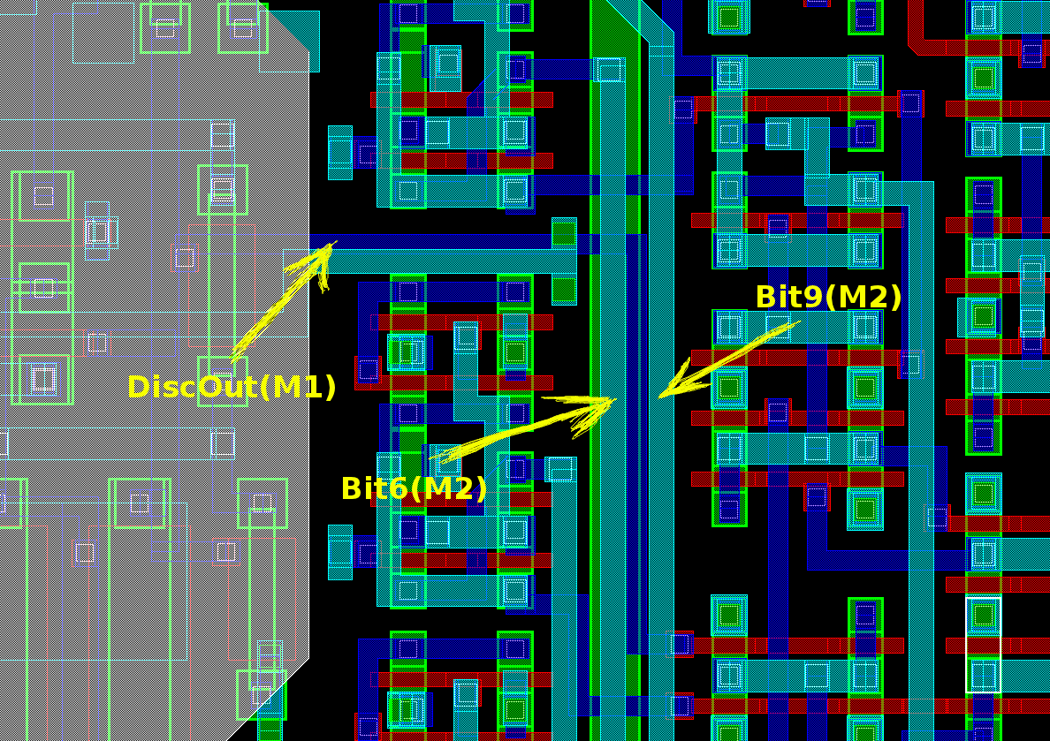
Noise in timepix tot spectrum
There is a capacitive coupling between DiscOut and Bit6 and9.
When the counter goes from 0 to 1 the pulse becomes longer and therefore it can tip over to the next value.
When the counter goes from 1 to 0 the pulse gets shorter and therefore the value more likely.

Slide 12
Defects in cdte sensors
Charge difts towards the center of the defect
Indication of high leakage current. (field/ikrum)

Slide 13
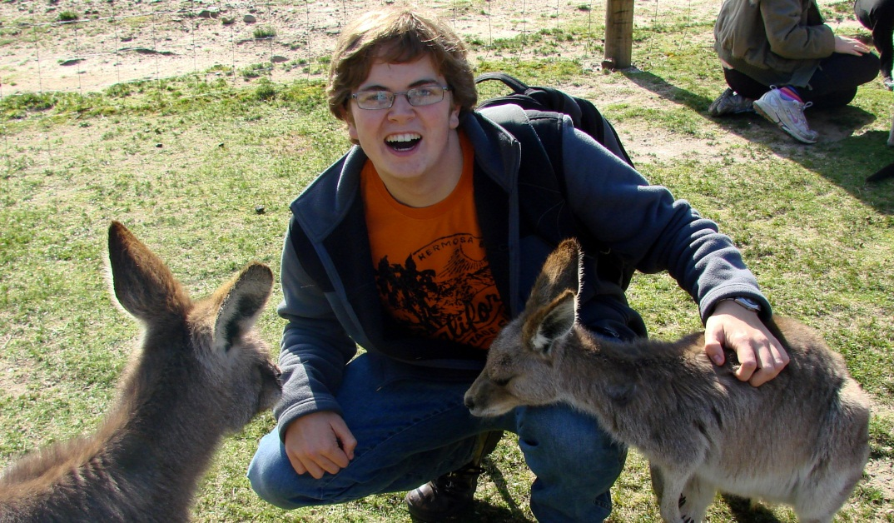
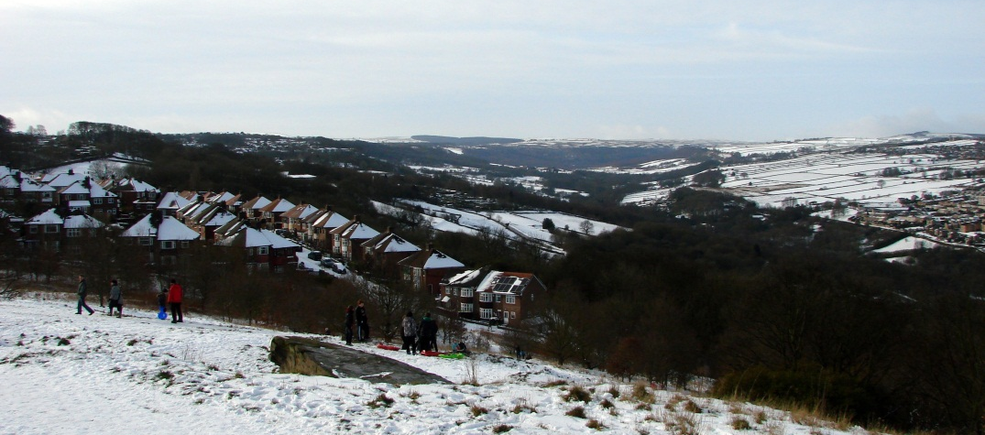
Stuart George – ESR4
I’m 24 and from the UK
Completed a Masters degree in physics from the University of Sheffield in computational stat mech.
My project focuses on the medical applications of the Medipix device as well as other active detector systems (for example GEM’s).
stuart.george@cern.ch

Slide 14
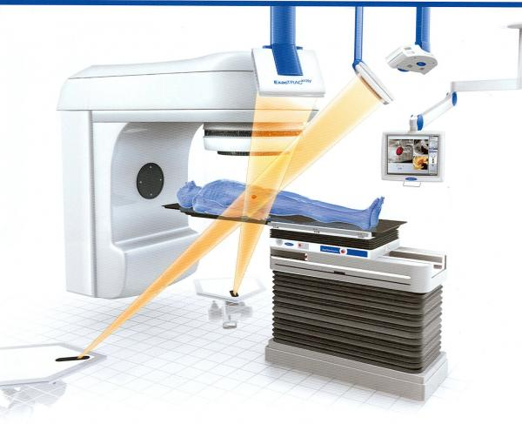
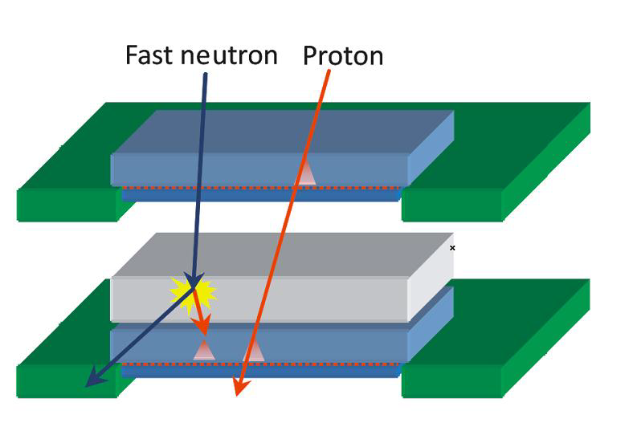
Undue radiation to the (conventional) radiotherapy patient
In-phantom measurement of out-of-field radiation doses.
Some work has been done on characterising doses outside of phantoms and in-phantom with passive dosimeters.
In addition, neutrons are generated for electron energies E > 10 MeV.
Medipix2 with converter layers should allow us to measure neutrons inside the phantom out-of-field and in-field, actively discriminating against the intense photon field.
We plan to carry out similar measurements in particle therapy.

Slide 15
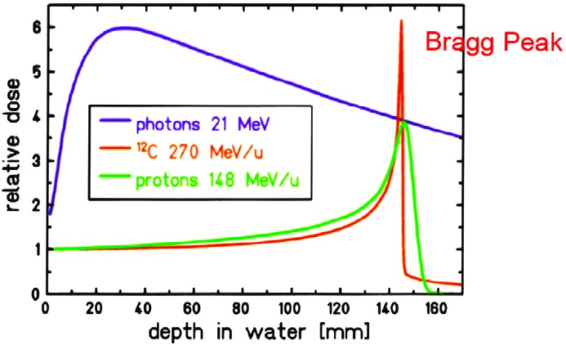
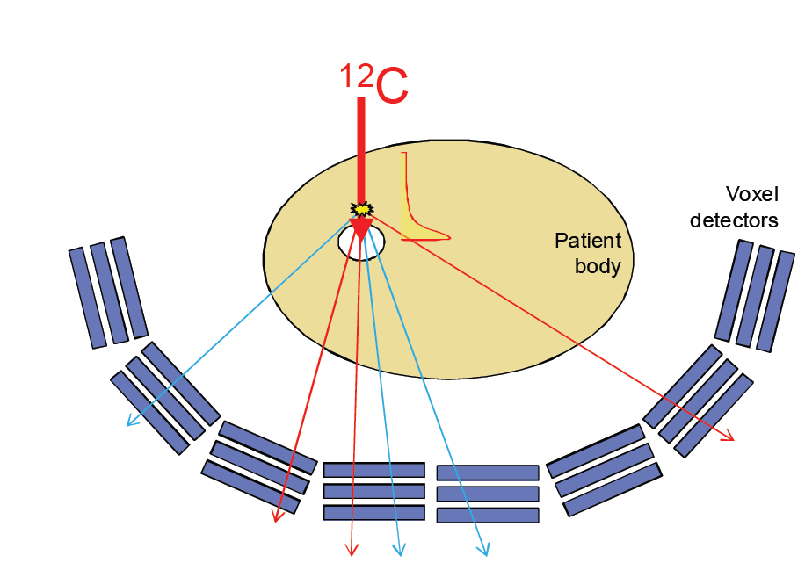
Ion Fragments in Carbon ion Therapy
During therapy with carbon ions the carbon beam suffers high levels of fragmentation before the Bragg Peak.
The small size of the timepix chip allows us to measure these fragments inside the phantom.
In addition we plan to continue the work done at CTU on vertex imaging from secondary radiation (0.1 secondaries/carbon)
Biochimica et Biophysica Acta 1796 (2009) 216–229

Slide 16
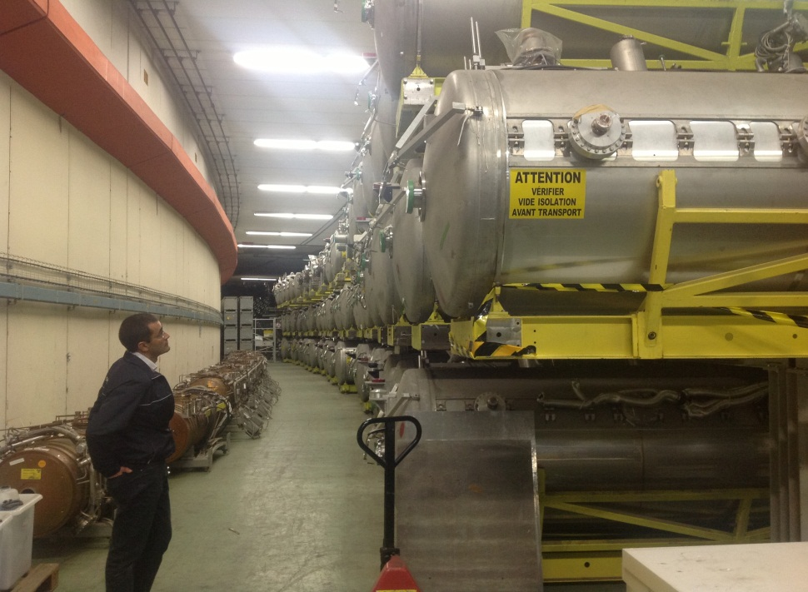
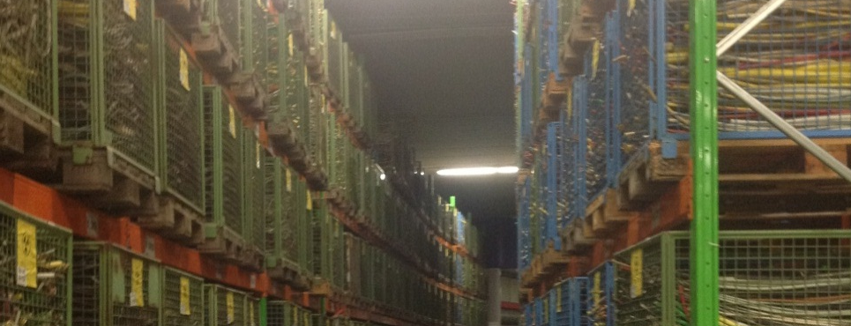
⁵⁵Fe Waste Characterisation
CERN has lots of low level radioactive waste stored at the old ISR site.
Some of this waste may be suitable for free release depending amongst other radionuclides, on ⁵⁵Fe levels (2.7 year half life).
⁵⁵Fe is hard to detect with conventional spectrometry due to its low energy of emission (5.9 keV x-ray).

Slide 17
Benedikt Bergmann – ESR 9
Born on 12th February 1987 in Kronach, Germany
Finished Master`s courses in Physics at FAU Erlangen in October 2012
  “Application of a time-resolving X-ray pixel detector in the detection of coincident fluorescence emissions after double K-shell vacancy production in the electron capture decay of Fe-55” , Master Thesis, ECAP
Since October 2012: PhD-student at FAU in Erlangen within the ARDENT project
  Work at the Institute of Exerimental and Applied Physics at CTU in Prague
  PhD-thesis will be supervised by Dr. Thilo Michel and Dr. Gisela Anton
Topic: “Optimization of mixed field data evaluation“
  Evaluate data taken by the ATLAS-Medipix detector network concerning dosimetric issues (neutron dosimetry)
  Contribute to the ATLAS upgrade from MPX to TPX during next shut down

Slide 18
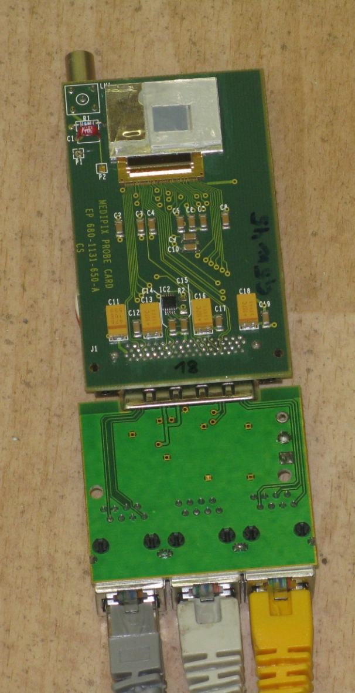
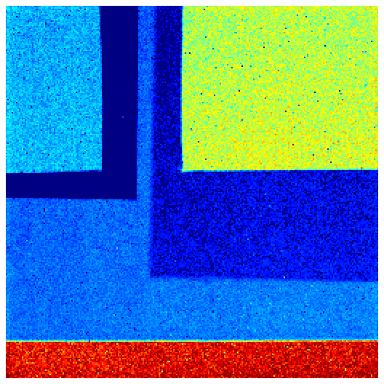
Neutron detection
Medipix 2 ASIC with 300µm Silicon layer
  256 x 256 pixel
Converter foils:
  ⁶Li(n,α)³H -> thermal neutrons
  PE: recoiled protons -> fast neutrons
LiF
PE
PE + Al
Al
Uncovered

Slide 19
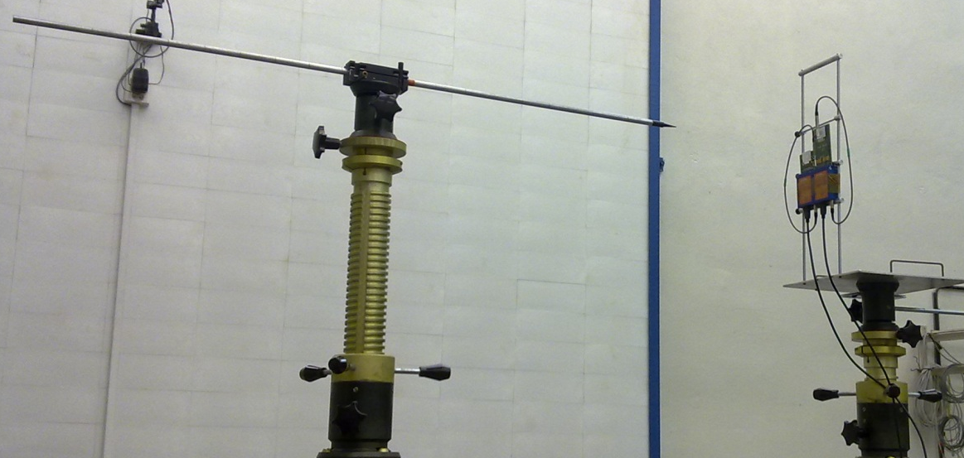
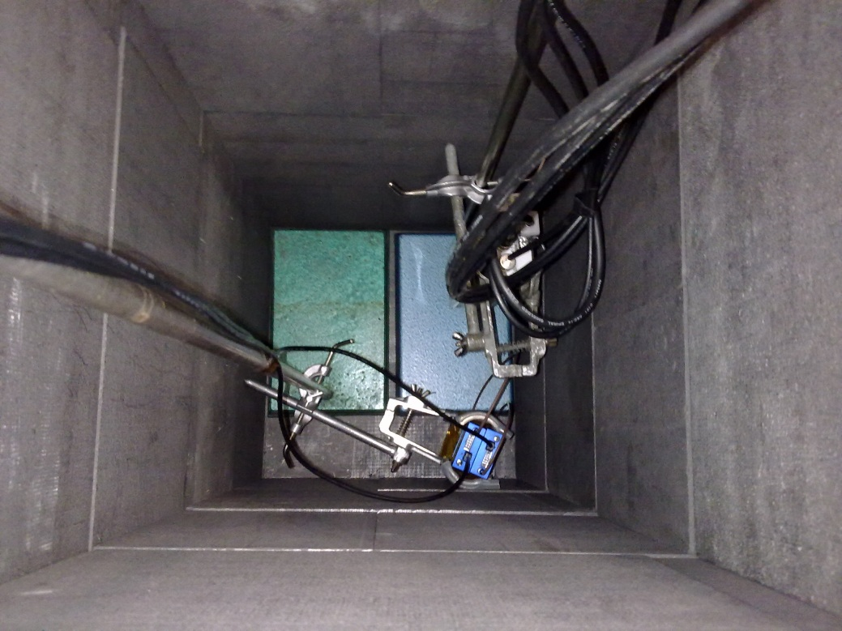
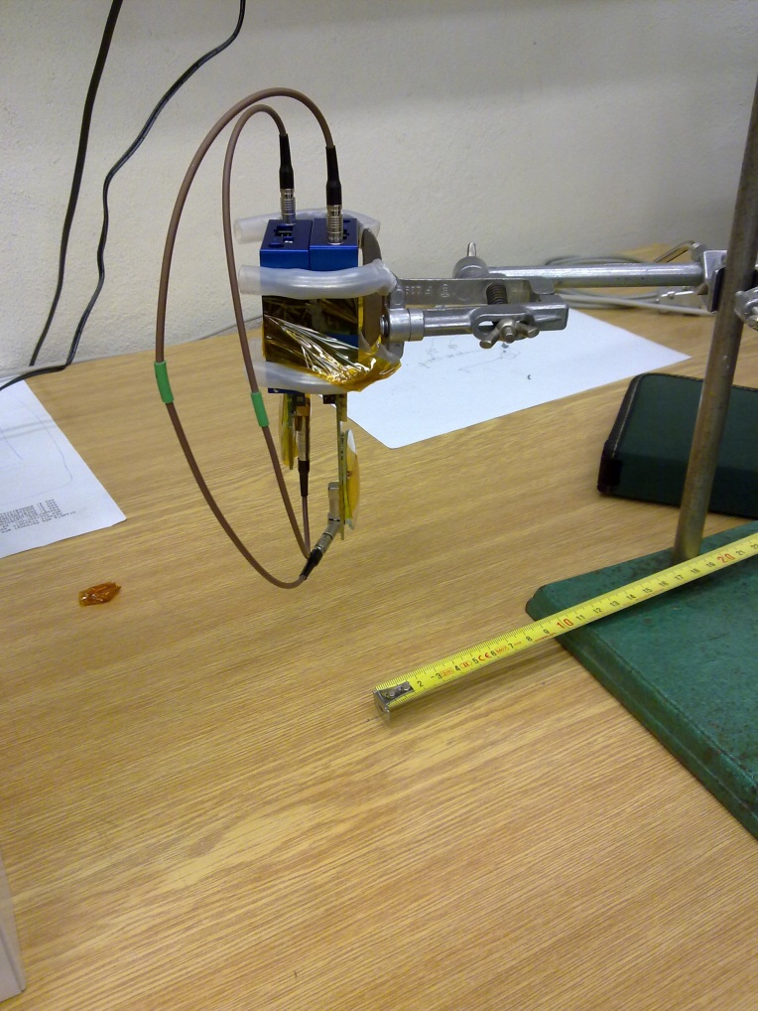
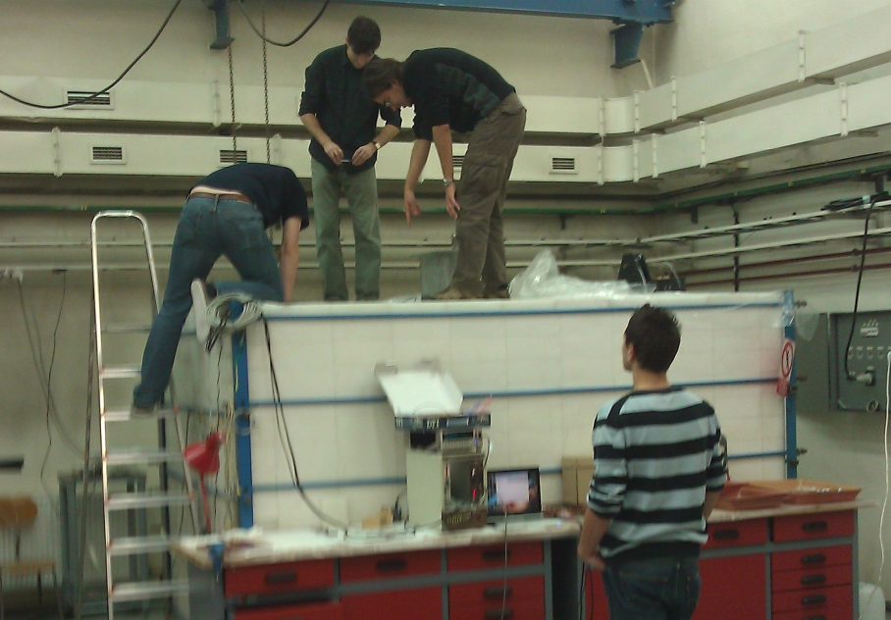
ATLAS upgraDe: Measurement at Czech Metrological Institute
fast neutron measurement
Upgrade from MPX to TPX
Comparison of response of MPX and TPX to thermal neutron and fast neutron impact (Cf, AmBe)
Calibrate TPX
thermal neutron measurement

Slide 20
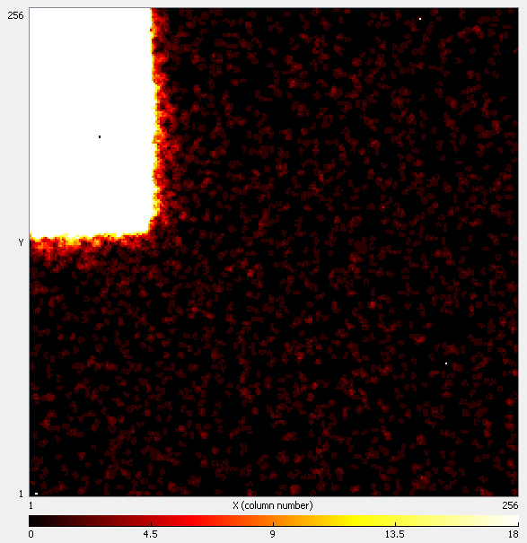
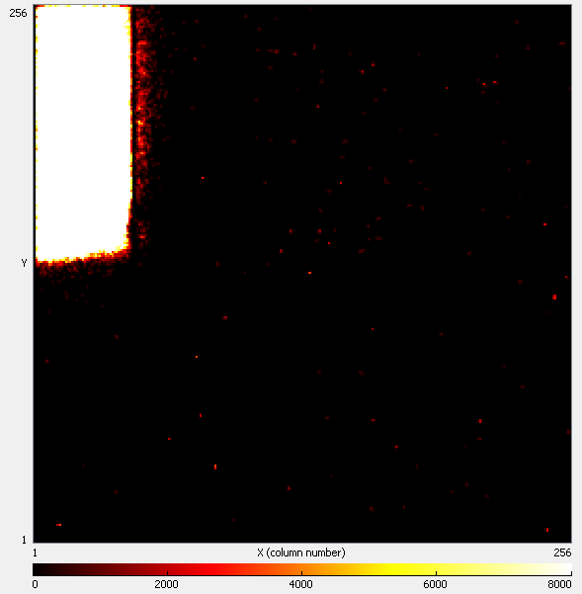
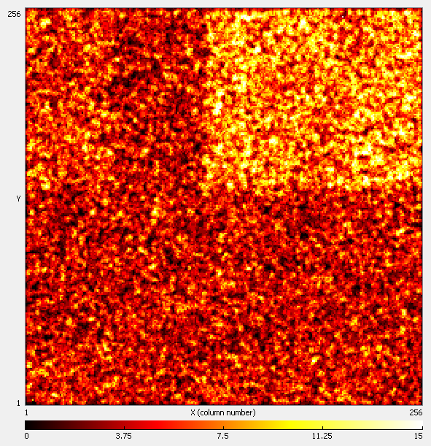
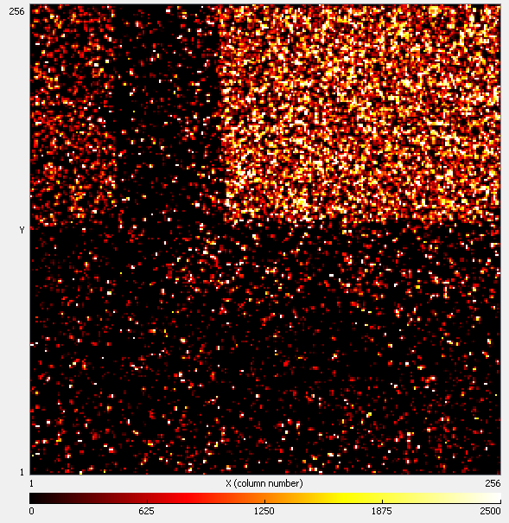
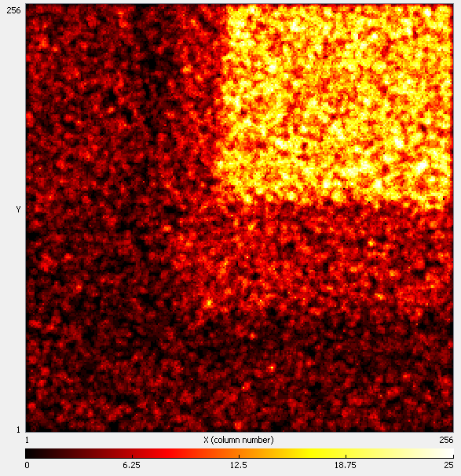
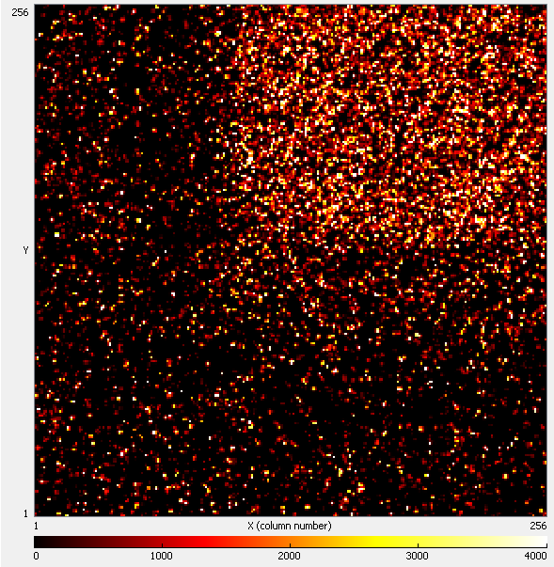
First comparison: MPX vs. TPX
²⁵²Cf (E_{mean} = 2 MeV)
MPX
TPX
thermal neutrons (E < 0.5eV)
MPX
TPX
MPX
TPX
AmBe (E_{mean} = 4 MeV)

Slide 21
Measured energy spectrum for the Thermal neutron Measurement – only TPX
Consists of Tritium and α-Peaks smeared out due to different interaction depths in the convertor
Criteria used:
  Minimum cluster size: 8 pixel
  Minimum cluster height: 100 keV
  Minimum cluster roundness: 0.76
N_{selected} = 97799
N_{all} = 618657
selected clusters only
all clusters

