Slide 1
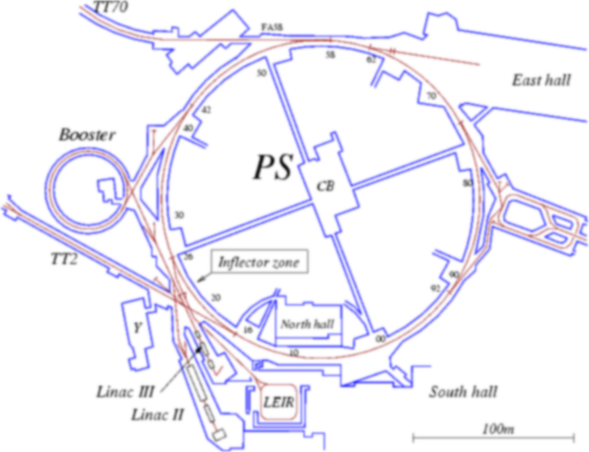
Instrument intercomparison in the stray radiation field around the CERN proton synchrotron
E. Aza, M. Caresana, C. Cassell, V. Colombo, S. Damjanovic, S. Gilardoni,
G.P. Manessi, M. Pangallo, D. Perrin, M. Silari
3rd June 2013, Aix-en-Provence
12th NEUtron and ion DOSimetry symposium

Slide 2
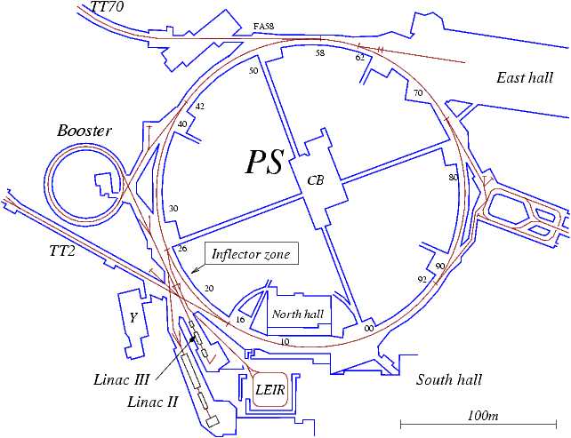
THE PS COMPLEX
BEAM
INJECTION
Beam accelerated from 1.4 GeV to 26 GeV
TO SPS
100 combined-function magnets interleaved by 100 straight sections (SS)
BEAM
EXTRACTION
E
Major losses due to beam injection and extraction
G.P. Manessi – Instrument intercomparison in the stray radiation field around the CERN PS
1/11

Slide 3
THE MEASUREMENT CAMPAIGN
Aim of the measurements: evaluate the difference in the responses of 6 active neutron detectors in different stray field conditions.
Focus: difference in the responses due to dead time losses.
Non-pulsed losses (200-300 μs), smoothed by 6-10 meters of ground shield
4 MEASURING
POSITIONS
Pulsed losses, low intensity (quite far from the
extraction septum)
Pulsed, intense losses (access tunnel to the extraction septum, limited shielding)
Several measurements carried out in 4 the positions
Systematic intercomparison at the access tunnel of SS16
G.P. Manessi – Instrument intercomparison in the stray radiation field around the CERN PS
2/11

Slide 4
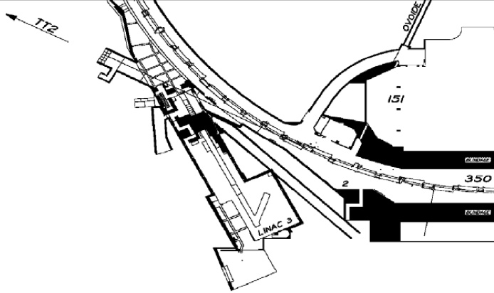
THE INTERCOMPARISON
MEASURING POINT
Beam extracted with Continuous Transfer (CT) technique
1% lost beam in the area: losses due to particles scattered by the electrostatic septum used to slice the beam
Beam extracted in 5 turns: each turn lasts 2.2 μs => length of the losses: 11 μs
6 detectors installed and rotated in reference positions at the beginning of the access tunnel
G.P. Manessi – Instrument intercomparison in the stray radiation field around the CERN PS
3/11

Slide 5
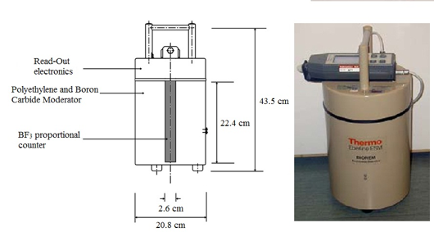
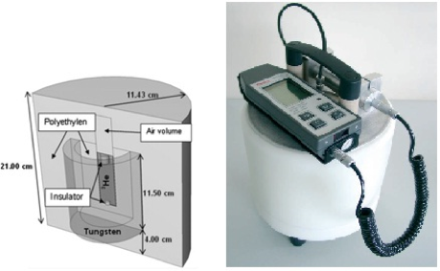
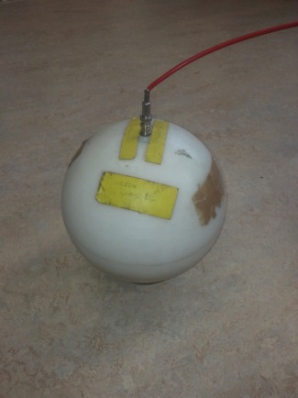
THE DETECTORS (I)
3 classes of instruments employed:
I) Conventional and extended range rem counters
Used for RP routine measurements
II) Ionization chambers
Employed in RAMSES (CERN RAdiation Monitoring System for the Environment and Safety)
III) Prototype extended range rem counter (LUPIN)
Thermo BIOREM (BF₃)
Conventional rem counter
Good sensitivity up to 20 MeV
Thermo Wendi-2 (³He)
Extended range rem counter
Good sensitivity up to 5 GeV
CERN LINUS (³He)
The original extended range rem counter
G.P. Manessi – Instrument intercomparison in the stray radiation field around the CERN PS
4/11

Slide 6
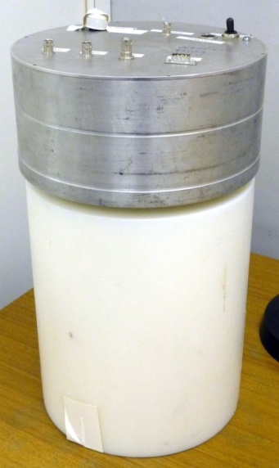
THE DETECTORS (II)
Pressurized (20 atm) Centronic ionization chambers (Ar and H)
Good sensitivity up to 20 MeV
LUPIN prototype (BF₃)
Extended range rem counter
Specifically conceived to work in pulsed neutron fields
It uses the integration of the total electric charge as a measure of the number of neutron interactions in the gas
G.P. Manessi – Instrument intercomparison in the stray radiation field around the CERN PS
5/11

Slide 7
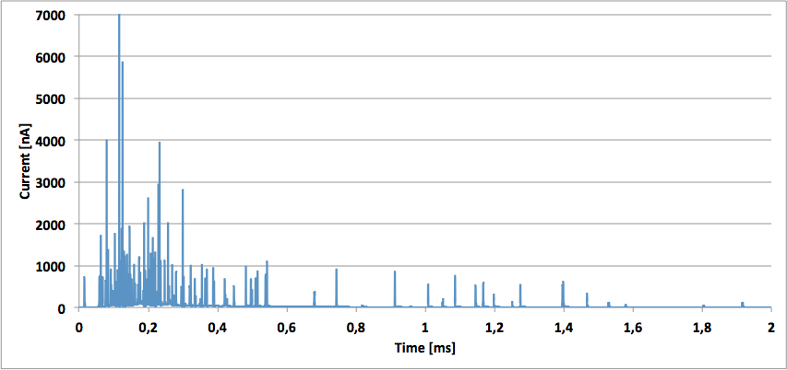
THE STRAY FIELD
Example of signal acquired with the LUPIN in one of the reference positions
250 INTERACTIONS IN 300 μs
NEUTRONS SCATTERED ALONG THE TUNNEL WALLS
THERMALIZATION &
DIFFUSION TIME
G.P. Manessi – Instrument intercomparison in the stray radiation field around the CERN PS
6/11

Slide 8
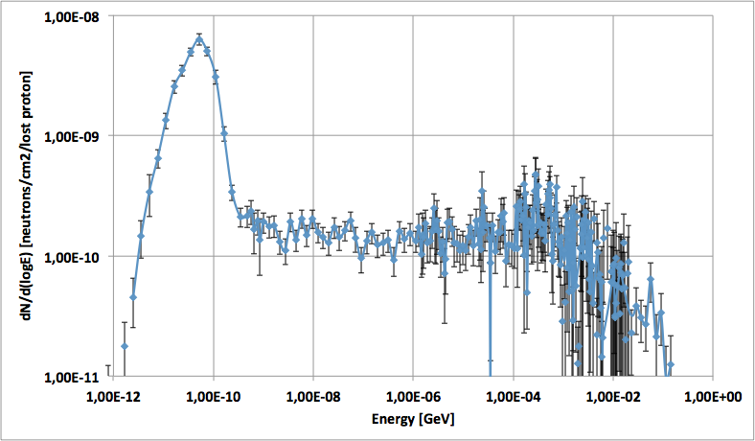
THE NEUTRON SPECTRUM
Expected neutron spectrum at the beginning of the access tunnel (FLUKA simulations)
Expected neutron H*(10) rate = 95% of the total H*(10) rate
Max neutron energy < 20 MeV => Same response for conventional and extended range RC
G.P. Manessi – Instrument intercomparison in the stray radiation field around the CERN PS
7/11

Slide 9
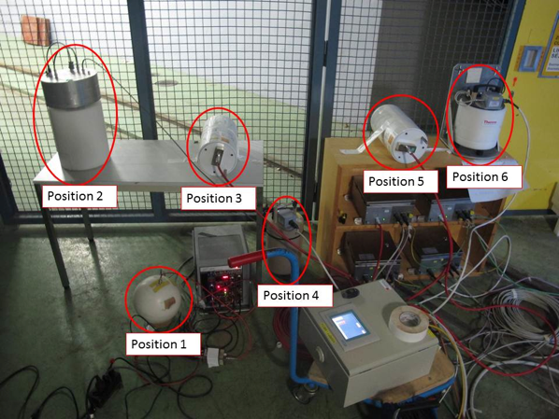
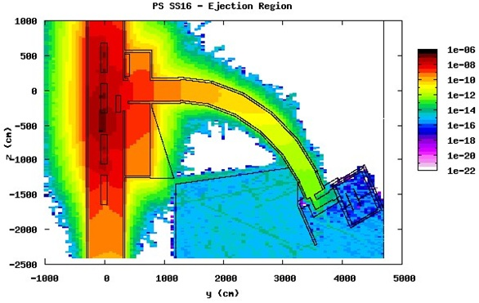
THE COMPARISON PROCESS
Detectors turned in the 6 reference positions
(high H*(10) rate gradient in the area)
Comparison of the integrated H*(10) (30 minutes) in each positions
EXPECTED H*(10) [μSv/lost primary]
Normalization of the H*(10) to:
Integrated proton fluence in the PS
H*(10) integrated by a fixed monitoring station installed in the area
G.P. Manessi – Instrument intercomparison in the stray radiation field around the CERN PS
8/11

Slide 10
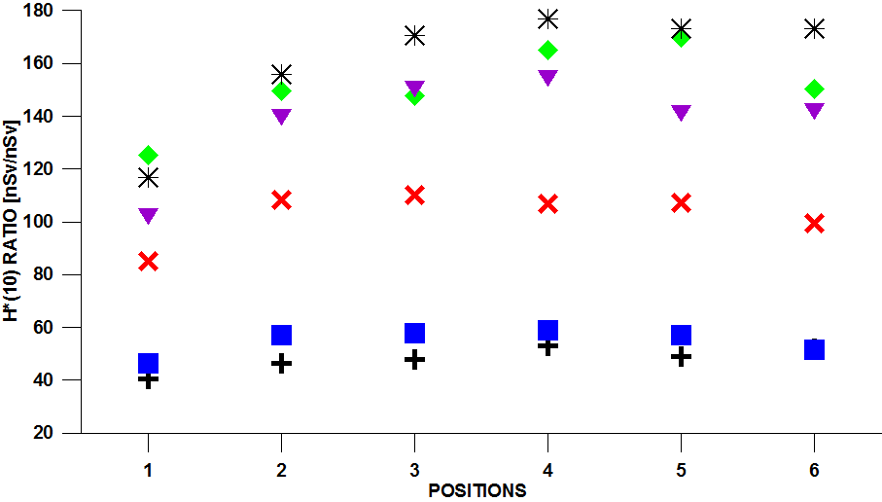
THE RESULTS
Data normalized to the H*(10) integrated by the fixed station
Non-constant losses during measurements (different beam cycles)
0
FLUKA
ION. CHAMBERS
& LUPIN
(NO DEAD TIME)
REM COUNTERS
DEAD TIME ≈ 1 μs
REM COUNTERS
DEAD TIME ≈ 2 μs
LOWER H*(10)
(CLOSE TO WALL)
G.P. Manessi – Instrument intercomparison in the stray radiation field around the CERN PS
9/11
Notes:
Uncertainties, not shown for clarity: 5% positioning, ≈1% statistical.

Slide 11
REMARKS
1) Ionization chambers & LUPIN (no dead time)
Results compatible within the range of uncertainty and with FLUKA simulations.
2) BIOREM (dead time ≈ 1 μs)
30% underestimation if compared to the average results of group 1 and FLUKA
1) Wendi-2 & LINUS (dead time ≈ 2 μs)
60% underestimation if compared to the average results of group 1 and FLUKA
n = expected counting rate ≈ 8.3∙10⁵ s⁻¹ (from LUPIN signal)
m = measured counting rate
τ = dead time ≈ 1 or 2∙10⁻⁶ s
From the dead time correction formula:
$$n=\frac{m}{1−mτ}$$
Expected underestimation due to the dead time effects:
45% for BIOREM; 65% for Wendi-2 & LINUS
G.P. Manessi – Instrument intercomparison in the stray radiation field around the CERN PS
10/11

Slide 12
CONCLUSIONS
LUPIN and IONIZATION CHAMBERS (H/Ar)
No underestimation of the expected H*(10)
Can be used in every working conditions, even with strongly pulsed fields.
Employed at CERN in all critical positions (pulsed, high energy losses).
LUPIN has the advantage of being portable (rem counter) and (unlike the ionization chambers) does not need the setting of a different calibration factor in each measuring position as a function of the neutron spectrum.
CONVENTIONAL REM COUNTERS (BIOREM, LINUS, Wendi-2)
Huge underestimations due to dead time
Real underestimation slightly lower than what calculated with the DT correction formula
(stray field partly scattered)
Used at CERN for environmental measurements or outside accelerator shieldings where radiation field is not strongly pulsed.
G.P. Manessi – Instrument intercomparison in the stray radiation field around the CERN PS
11/11

Slide 13
Instrument intercomparison in the stray radiation field around the CERN proton synchrotron
THANK YOU FOR YOUR ATTENTION
E. Aza, M. Caresana, C. Cassell, V. Colombo, S. Damjanovic,
S. Gilardoni, G.P. Manessi, M. Pangallo, D. Perrin, M. Silari

Slide 14
DEAD TIME CALCULATIONS
To derive the dead time for each detector the “two-source method” [Knoll] was applied to the data acquired in a dedicated experiment.
Method based on observing the counting rate from two sources individually and in combination. Applied by taking three different values of expected and measured counting rates, i.e. EXP₁, EXP₂, EXP₁₂ and MEAS₁, MEAS₂, MEAS₁₂, where EXP₁₂ = EXP₁ + EXP₂, and by evaluating them individually and in combination.
The dead time could be calculated from the discrepancy between the measured rate MEAS₁₂ and the sum of MEAS₁ + MEAS₂.
(1.02 ± 0.10) µs for the BIOREM
(very close to the TTL pulse width declared by the manufacturer, 1.2 µs [Thermo])
(1.74 ± 0.17) µs for the Wendi-2
G.P. Manessi – Instrument intercomparison in the stray radiation field around the CERN PS
Backup 1

Slide 15
RESPONSE FUNCTIONS
H20
Wendi-2
A20
BIOREM
LINUS
LUPIN
G.P. Manessi – Instrument intercomparison in the stray radiation field around the CERN PS
Backup 2

Slide 16
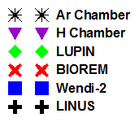
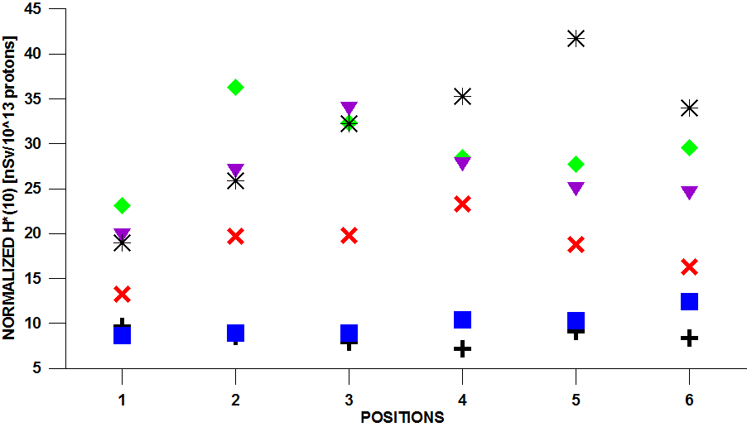
NORMALIZATION TO PS FLUENCE
Data normalized to integrated proton fluence in the PS
G.P. Manessi – Instrument intercomparison in the stray radiation field around the CERN PS
Backup 3

