Slide 1

THE ARDENT PROJECT AND Neutron detection with TimePix devices
Erlangen Center For Astroparticle Physics, December, 20th 2012

Slide 2
OverView
The ARDENT project
      What is the ARDENT project?
      Why is it interesting for students?
      Examples of work done within this project
      Impressions of the first workshop in Vienna
  Neutron detection with MPX/TPX devices
      Working principle of hybrid pixel detectors
      Neutron detection and conversion layers
      The ATLAS-Medipix detector network
      Proposed upgrade from MPX to TPX

Slide 3
The Ardent Project

Slide 4













ARDENT
February 2012 – January 2016
Advanced Radiation Dosimetry European Network Training initiative
Marie Curie Initial Training Network under EU FP7 – 4 M€
7 Full Partners and 5 Associate Partners
Coordinator: CERN, Scientist-in-Charge: Dr. M. Silari
CERN (coordinator), Switzerland
AIT Vienna, Austria / Siebersdorf Laboratories
CTU- IAEP Prague, Czech Republic
IBA Dosimetry, Schwarzenbruck, Germany
Jablotron, Prague, Czech Republic
MI.AM, Milano, Italy
Politecnico, of Milano, Italy
ST Microelectronics, Italy
University of Erlangen, Germany
University of Houston, USA
University of Ontario, Canada
University of Wollongong, Australia
Notes:
Was launcht in February 2012 – 3 years
It is part of the Marie Curie IT Network under this EU FP7 program – Budget = 4MEuro
The 7 full partners are

Slide 5
Development of advanced instrumentation for radiation monitoring…
Three main technologies
Gas detectors [e.g., gas electron multipliers (GEM), tissue equivalent proportional counters (TEPC)]
Solid state detectors [e.g., Medipix, silicon micro-dosimeters]
Track detector techniques [e.g., CR-39, nano-dosimeters]
We can still add detectors / technologies we think are worth investigating!
Notes:
The goal of the work done within this framework is to develop advanced intruments for radiation monitoring.
-Track detector techniques- plastic foils
… This is not finalized: If there are interesting new detector concepts they can alos be added

Slide 6
Objectives & Applications
Main objectives
  Radiation dosimetry
  Micro- and nano-dosimetry
  Photon and neutron spectrometry
Applications
  Characterization of radiation fields at particle accelerators (research, industry, medical)
  Characterization of radiation fields on-board aircrafts and in space
  Assessment of secondary dose to RT patient
  Measurement of properties of clinical hadron beams
Notes:
These detcetors will be used for the.
Applications of this can be found in … I will show a few examples later.
Or in medical applications like Radiation Therapy or Ion Beam Cancer Treatment

Slide 7
Researcher Recruitment
15 Early Stage Researchers (ESR), 9 already recruited
  4 at CERN: Eleni Aza (Gr), Erik Frojd (Se), Stuart George (GB), Silvia Puddu (It)
  2 ait AIT / SL, Vienna: Andrej Sipaj (Sl)
  3 at CTU, Prague: Benedikt Bergmann (DE), Kevin Loo (AU)
  2 at IBA Dosimetry, Schwarzenbruck
  1 at Jablotron, Prague: Vijayaragavan Viswanathan (India)
  1 at MI.AM, Milano: Alvin Sashala Naik (Mauritius)
  2 at the Politecnico, Milano: Chris Cassell (AU), Eleni Sagia (Gr)
Up to 1/3 of time can be spent on secondments
Work performed within the project to be used for PhD
Generous training allowance for researchers
Notes:
Here is the current status of the recruitment. 9 out of 15 positions are already filled. So there are still a few vacancies.
IBA is not intereting for you because due to some restrictions of the EU you are just allowed to aply for jobs abroad.
The duration of the recruitment is 3 years, but there is also the possibility to spent some time up to 1/3 of this time at secondments.
In my case I have a work contract at CTU, but I will spend 10% uf the time at CERN, and the other 20% probably here in Erlangen, as Thilo and Gisela are the superviesors of my PhD. This is also the next point:
So this network is there to encourage youg reasercher to obtain the PhD.
There is a huge amount of money for each ESR that can be used for individual training (conferences, workshops, training courses).

Slide 8
Work Packages
Seven Work Packages
  WP1: gas detectors (Sofia Rollet, AIT, Vienna)
  WP2: solid state detectors (Zdenek Vykydal, CTU, Prague)
  WP3: track detectors (Marco Caresana, Politecnico, Milano)
  WP4: instrument inter-comparison (Matteo Magistris, CERN)
  WP5: training
    Individual training programs
    Network-wide training
  WP6: dissemination and outreach
  WP7: ITN management
Notes:
The work performed in the framework is divided into 7 work packeges with different persons in charge of it. These work packages are …
I will participate e.g. WP2 ,WP4, WP5 – management courses aat CERN or Workshops
What I am now doing can be found in WP6.

Slide 9
ARDENT Structure
Supervisory Board (SB)
Administrative support unit (CERN)
ITN Management Office
Scientist in Charge
Selection Committees
Technical Training Board
(Leaders WP 1-4)
Training Board
(WP 5)
Dissemination and Outreach Board (WP 6)
http://cern.ch/ardent
Notes:
Here is just an overview over the structure of different boards that take care that everything works.
I do not want to go into details as I do not understand all of them either. But I should mention that there is a representative of the ESRs in the Supervisory board. So the interest of the ESR will be repsresented somehow.

Slide 10
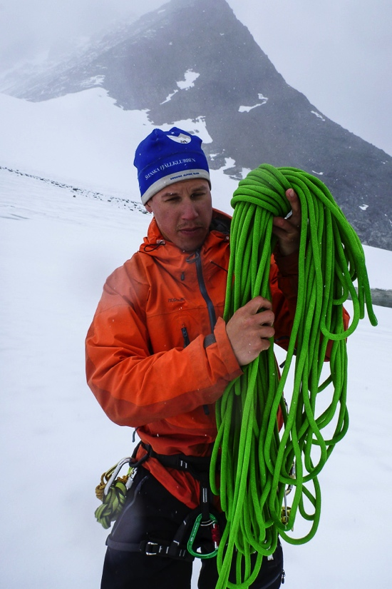
ERIK FRÖJDH – ESR 2
28 Years old
Born in Sundsvall, Sweden
Education
  Master of Science degree in Physics from
  Mid Sweden University Jan 2010
  Admitted as a PhD student at
  Mid Sweden University ( Feb 2010 )
Work within ardent
  Application of Timepix as a dosimeter in space and around accelerators
  Characterization of Medipix3RX and Timepix 3
  Medipix support for the other ESRs
Notes:
Now I will show a few examples of work done in this framework. So this is Erik Fröjdh from Sweden. He is now based at CERN.
The following sildes are slides presented by the indivudual ESRs at the Medipix meeting. So I will just summarize them.
Erik will work more on the technical side, meaning detector development and charactrization.
So he will work on…
And he help the other ESR working with these devices.

Slide 11
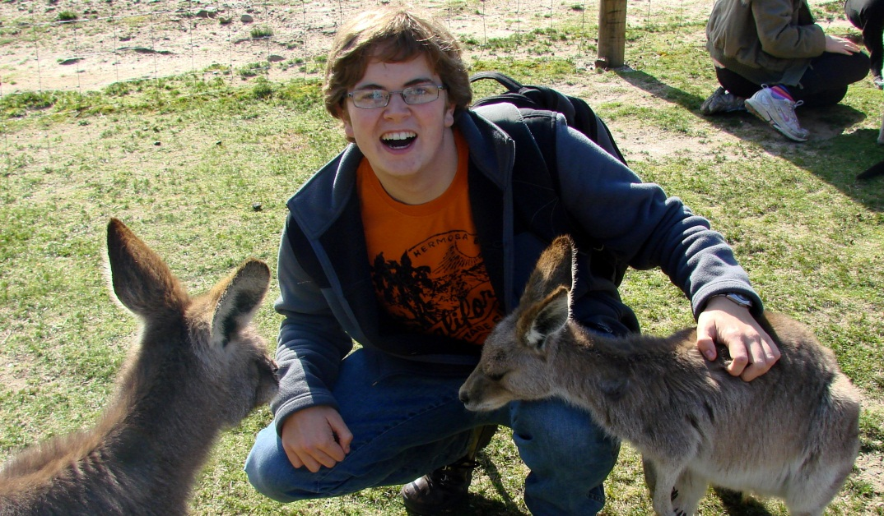
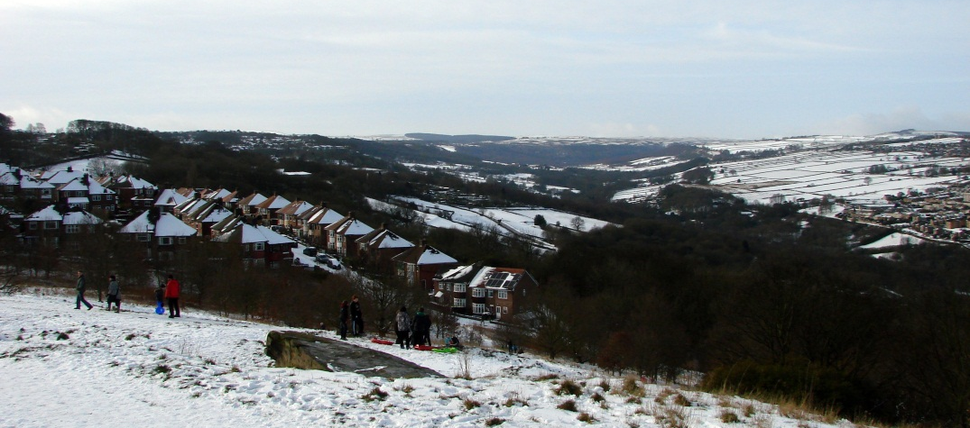
Stuart George – ESR4
I’m 24 and from the UK
Completed a Masters degree in physics from the University of Sheffield in computational stat mech.
My project focuses on the medical applications of the Medipix device as well as other active detector systems (for example GEM’s).
stuart.george@cern.ch
Notes:
The next one is Stuart Patrick George from England. He is also the elected ESR representative in the Supervisory board.
He is goint to work with GEM and Timepix devices mainly in medical applications

Slide 12
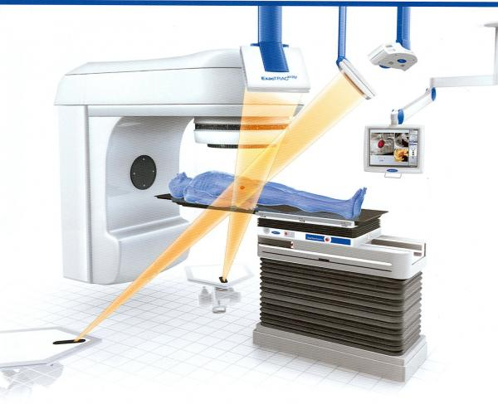
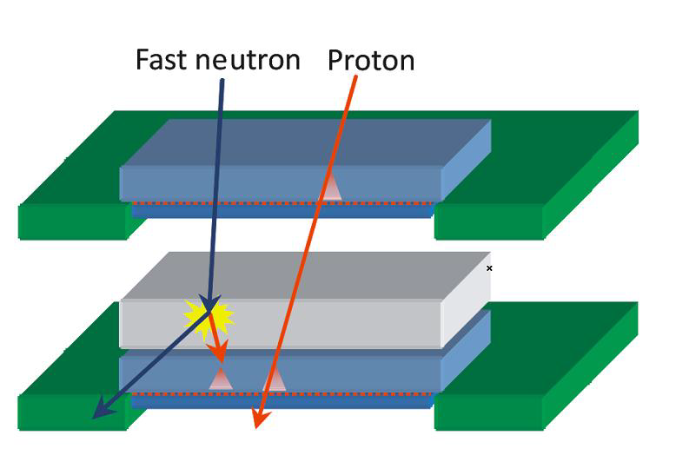
Undue radiation to the (conventional) radiotherapy patient
In-phantom measurement of out-of-field radiation doses.
Some work has been done on characterising doses outside of phantoms and in-phantom with passive dosimeters.
In addition, neutrons are generated for electron energies E > 10 MeV.
Medipix2 with converter layers should allow us to measure neutrons inside the phantom out-of-field and in-field, actively discriminating against the intense photon field.
We plan to carry out similar measurements in particle therapy.
Notes:
IN the conventional RT:
-in phantom measurements of doses … therefore he will use a stack of TPX devices shown here, which allows to distingiush between protons and neutrons. But I will say a few more words on this later.

Slide 13
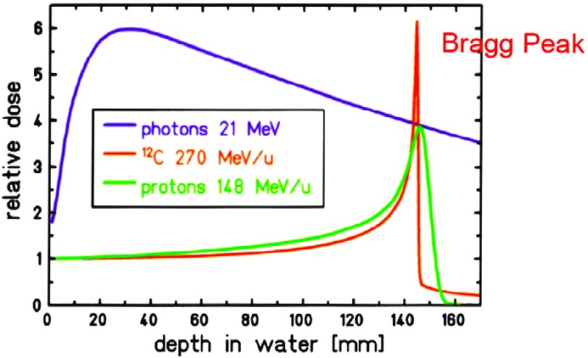
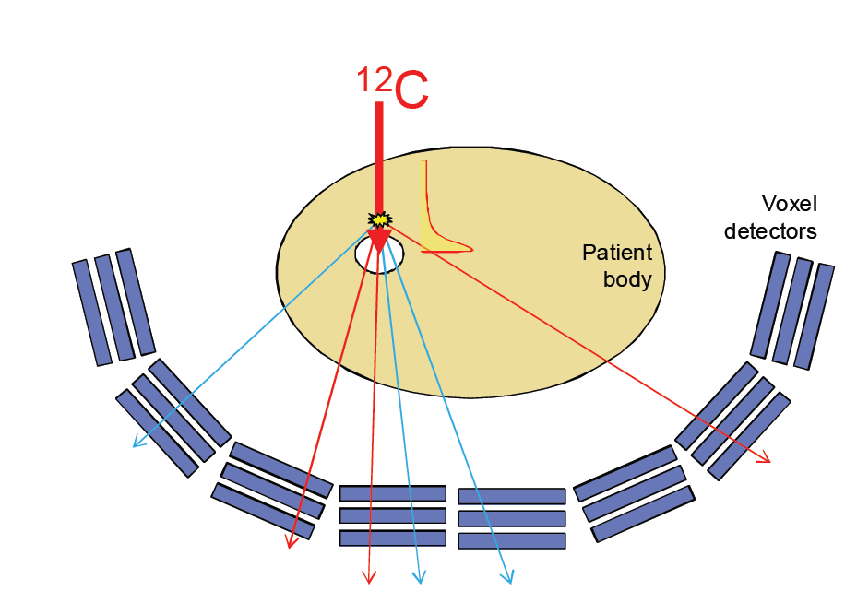
Ion Fragments in Carbon ion Therapy
During therapy with carbon ions the carbon beam suffers high levels of fragmentation before the Bragg Peak.
The small size of the timepix chip allows us to measure these fragments inside the phantom.
In addition we plan to continue the work done at CTU on vertex imaging from secondary radiation (0.1 secondaries/carbon)
Biochimica et Biophysica Acta 1796 (2009) 216–229
Notes:
Another application is in Ion Beam cancer treatment:
This Ion beam cancer treatment has the advantage that the location of the maximum energy deposition in the human body can be adjusted quite well using the Bragg-Peak behaviour of a charged particle. So the surrounding tissue does not suffer that much dose than with the photon therapy.
But you can imagine if you do not aim well you will kill the wrong cells in the body.
Bragg peak: Advantage – Energy deposition quite sharp -> less dose for surrounding organs or tissue BUT you have to aim really well

Slide 14
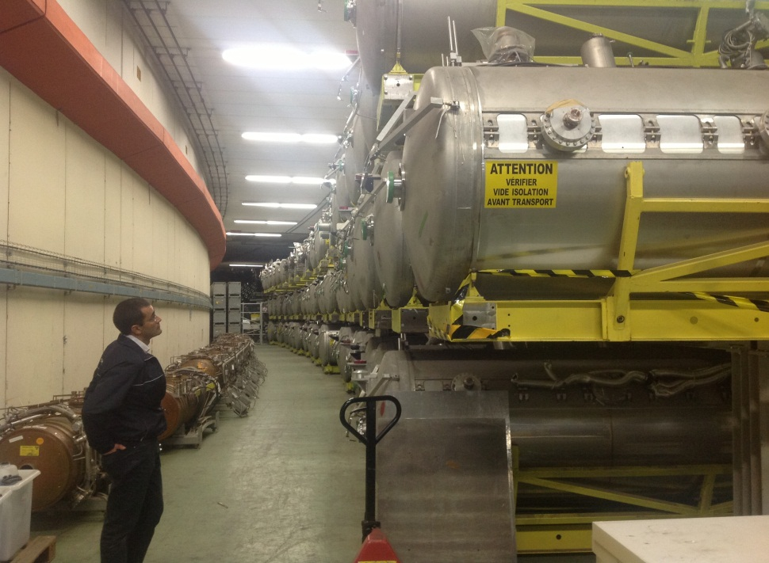
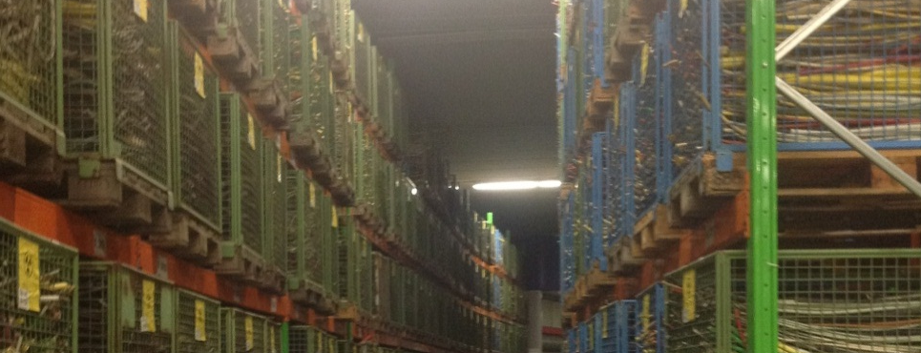
⁵⁵Fe Waste Characterisation
CERN has lots of low level radioactive waste stored at the old ISR site.
Some of this waste may be suitable for free release depending amongst other radionuclides, on ⁵⁵Fe levels (2.7 year half life).
⁵⁵Fe is hard to detect with conventional spectrometry due to its low energy of emission (5.9 keV x-ray).
Notes:
And e.g. at CERN there is a lot of low level radioactive waste that emitts low energy photons like FE-55 with 5.9keV
This energy is not seen by the typical dosimeters.

Slide 15
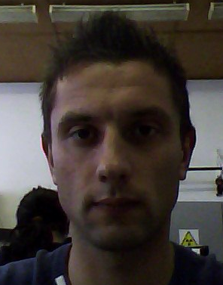
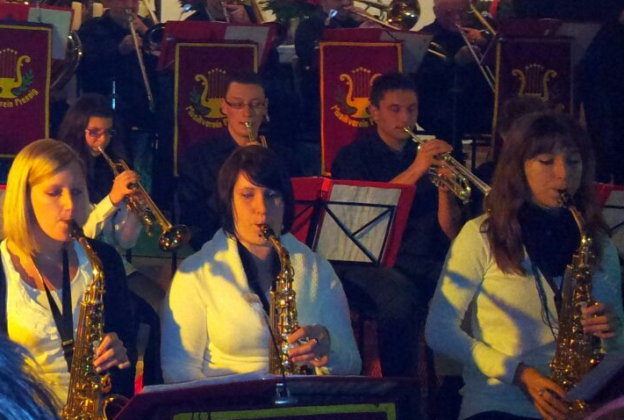
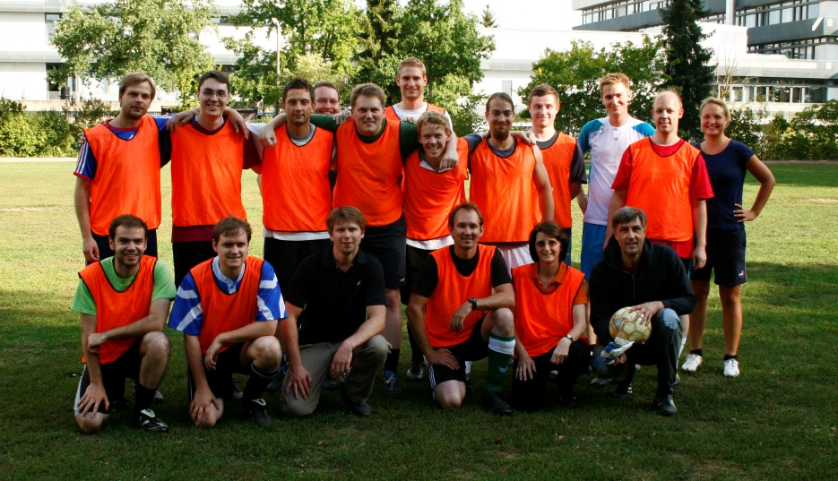
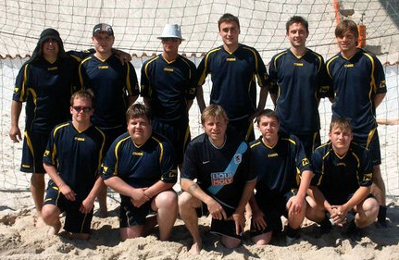
Benedikt Bergmann – ESR9
X-mas Concert (2011)
Benedikt Bergmann
Germany, Pressig
12th February 1987
Work in the ARDENT program
  Evaluation of data taken by the ATLAS-MPX detector network focussing on neutron dosimetric issues
  ATLAS MPX to TPX upgrade
Bavarian Beach Soccer Champion (2010)
ECAP vs. Theory 4:1 (2012)
Notes:
The third example. I will work on the evaluation of data taken by the ATLAS-MPX detector network
Contribute to the Upgrade from MPX to TPX.

Slide 16
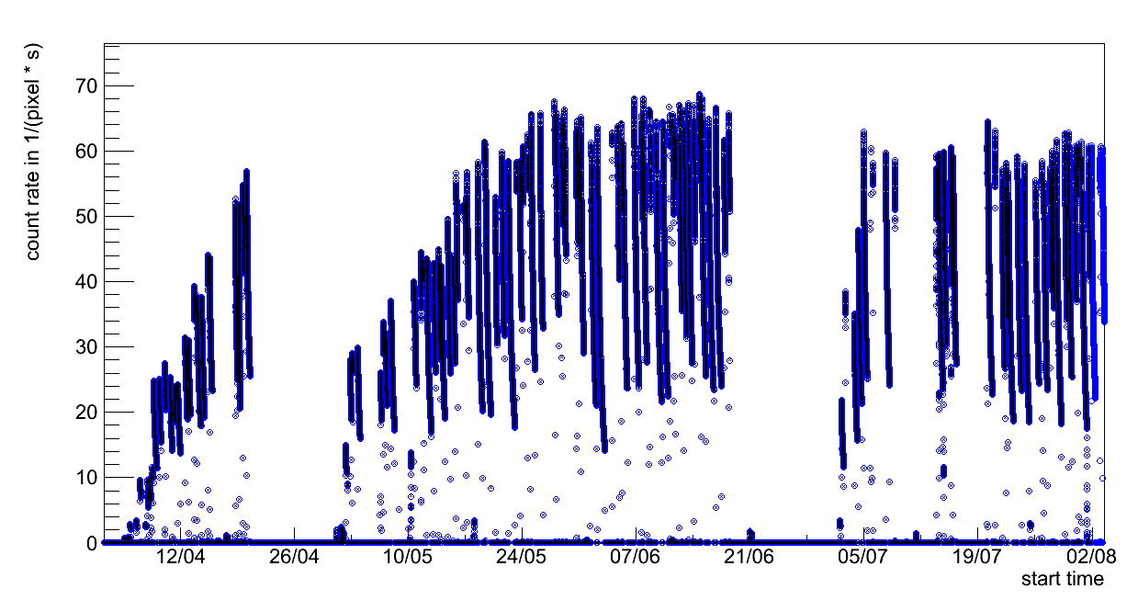
Studies on activation in the ATLAS cavern
Activation of surrounding material during collisions in the ATLAS detector
  Luminosity monitoring with MPX devices: Background contribution
  Dosimetric aspect: What is the time dependency of the equivalent dose rate after the collisions?
collision region
?
Notes:
Here are a few results of my work. So I study the Activation in the ATLAS cavern. Why is that interesting: During the collisions the surrounding materials and the detectors itself get activated. Now, for the Shut down or if there has to be something repaired, I would like to know at what time after a collision I can safely enter into the cavern.
What can you see here. Coutrate over time …Peaks are collisions and I am especially interested in the time after these collisions

Slide 17
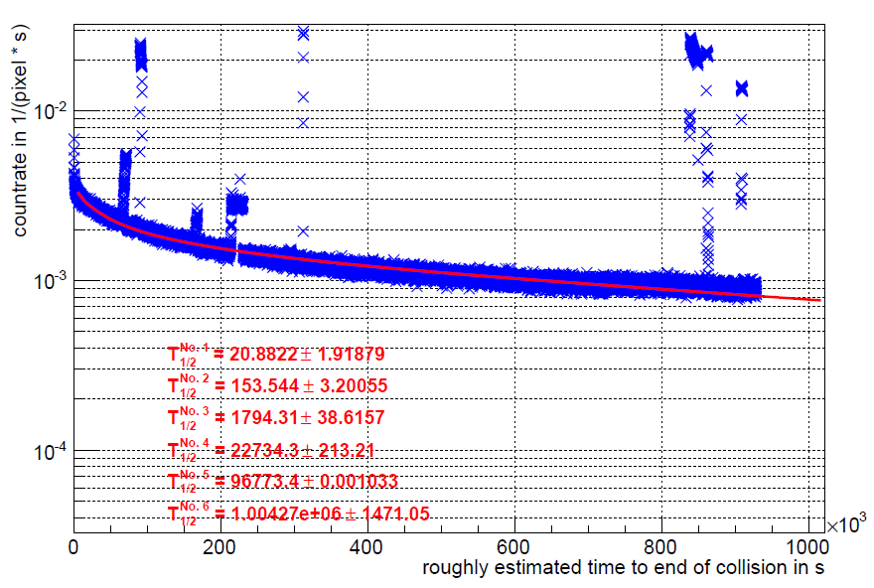

Modelling the decay of activation products
$$f\left(x\right)=\sum_{i=1}^{6}{k_{i}∙e^{−\frac{ln⁡(2)}{T_{1/2}^{i}}∙t}}$$
components with longer half life present
Notes:
So.. As a start I modeled the decay of all of the activated products as a sum of 6 Exponential decays. The function is given here and the half lives were obtained by fitting. What one can see on the slope is that there are some longer decay components missing.

Slide 18
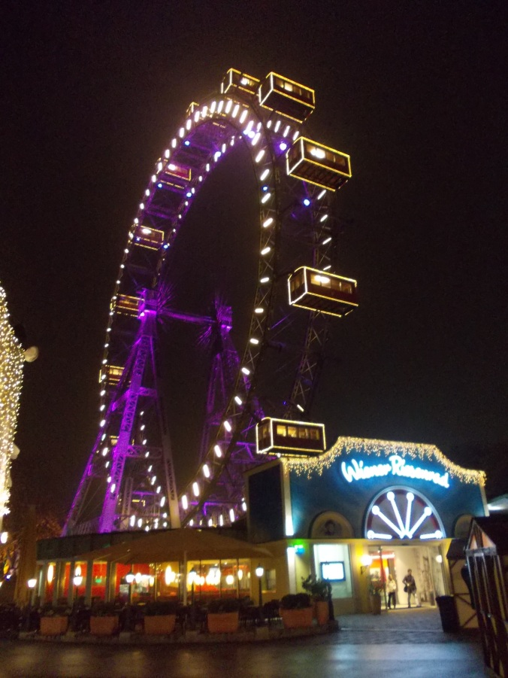
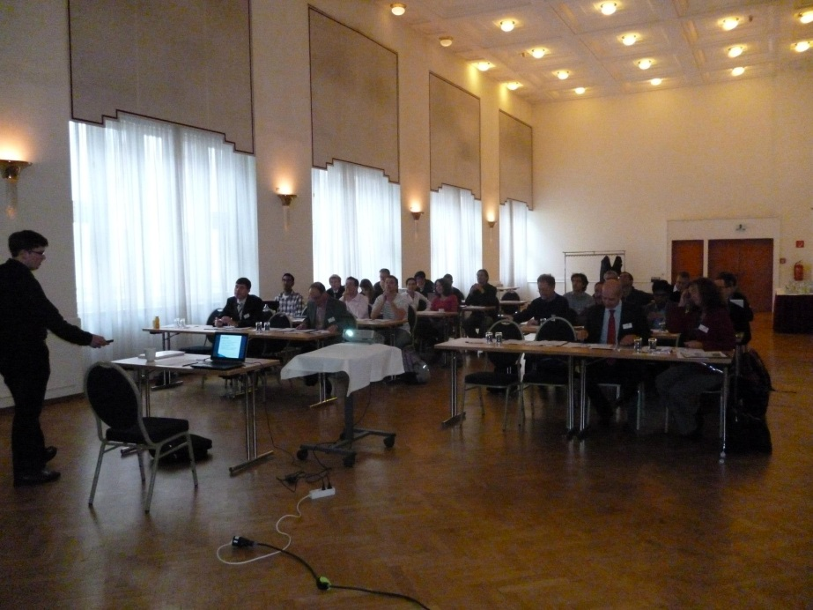
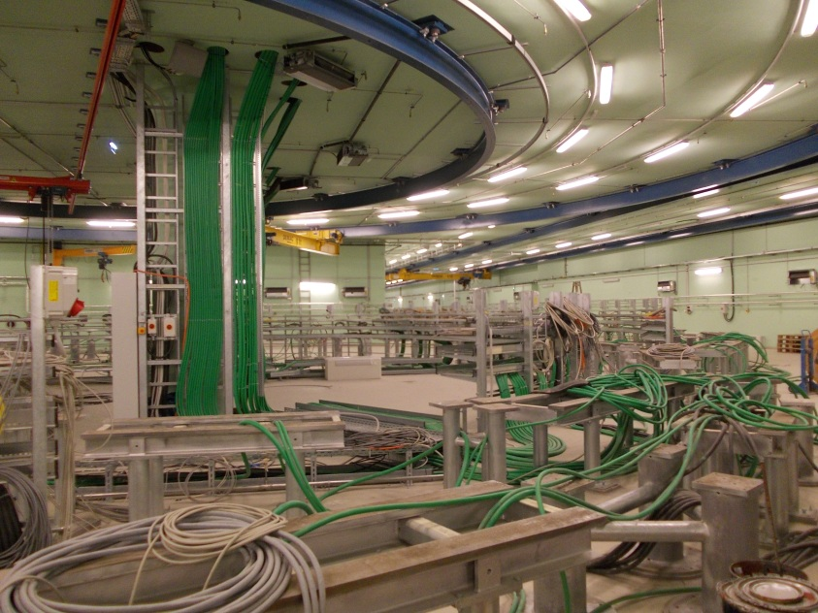
IMPRessions of the 1st Annual Workshop in vienna
Hard work: lectures from 9:00 to 18:30 (3 days)
Getting to know other countries and cultures
Visiting institutes on the cutting-edge of technology
Notes:
Here are now a few Impressions of the 1st ARDENT network wide workshop that took place last month in Vienna. Is consists of really hard work….
But there was also some time, especially in the evening to see the sights of Vienna.
What was also interesting was the visit to MedAUSTRON where you could see a proton and CARBON cancer treatment centre that will be constructed.

Slide 19
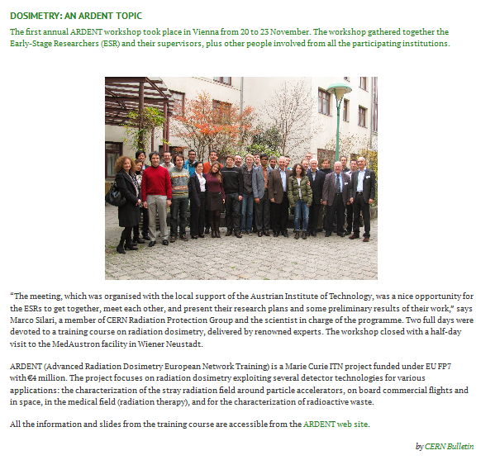
“Article in CERN Bulletin about the 1st annual ARDENT workshop“ taken from
http://cdsweb.cern.ch/journal/CERNBulletin/2012/49/News%20Articles/1496550?ln=en
Notes:
A report of this Workshop can also be found in the CERN bulletin. This is outreach!

Slide 20
Summary
The ARDENT project offers:
    The possibility to spend some time abroad
    Working on the cutting-edge of technology
    Getting to know people from other institutes
    Really good training possibilities
  There are still vacant jobs!
  http://ardent.web.cern.ch/ardent
Notes:
So to summarize the first part of this talk:
Feel free to visit the ARDENT webpage.. If you have question either contact me or Thilo should also be a good choice to adress these questions.

Slide 21
Neutron detection with TIMEpix Detectors
Notes:
Now let me come to the physical part of the presentation. I hope this will be more interesting for you – So if you were sleeping now is the right time to wake up again ☺.
This part deals with the NEUTRON DETECTION with TIMEPIX DEVICES

Slide 22
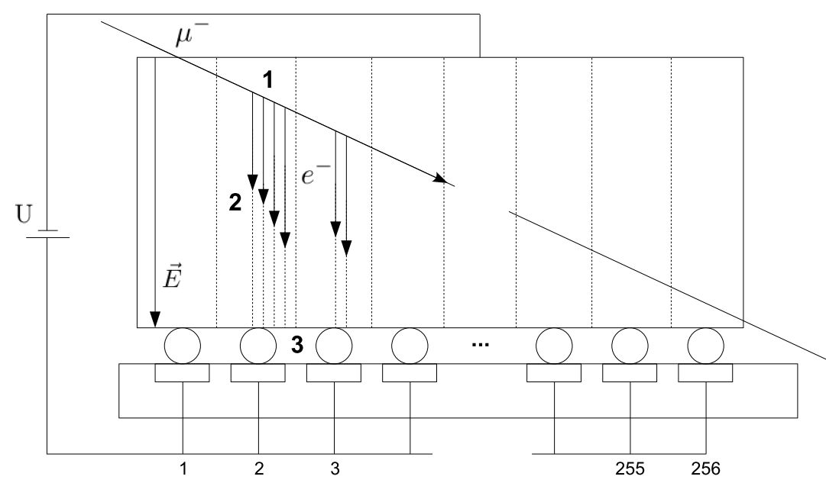
Detection Principle of a Hybrid pixel detector
Notes:
How does a MPX or TPX device work?
If charged particle crosses the detector e- + h+ pairs are created. Due to an applied electric field these charge carriers are drifting to the electrodes. ON their way they induce charge at the pixel electrodes. In this pixel electrodes with a CSA an voltage pulse is generated.

Slide 23
Three Modes of Operation
V
Shaped Voltage Pulse
Analogue
Threshold
t
Start Frame
End frame
Counting (Medipix2,3 & Timepix)
Time of Arrival (TOA) (Timepix)
Time over Threshold (TOT) (Timepix)
Notes:
A model of this Voltage pulse is shown here. It is used in the 3 different modes is different ways.

Slide 24
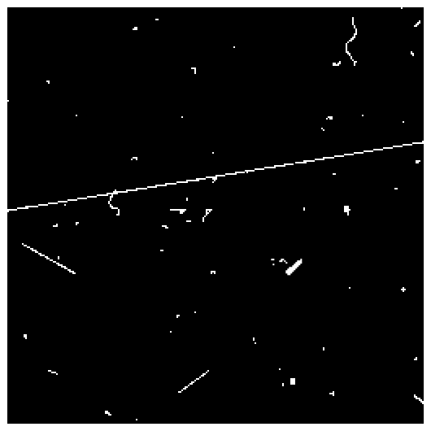
Cluster analysis and pattern recognition algorithm
3)
Set of criteria can be established in order to resolve those different shapes:
  Area (number of pixel) in the cluster
  Roundness (surface compared to length of the border)
  Linearity (possibility to interleave track with line)
  Thickness of the straight track
1)
6)
5)
2)
4)
Typical frame recorded in a mixed radiation field
Notes:
Here you can see a typical frame recorded in MPX counting mode in a mixed radiation field. One can see different pattern:
e.g. 1) dots 3) curly tracks 6) myon 5) heavy track
These different shapes can be characteized using several criteria, Area .. , Roundness

Slide 25





Tracking capability – Characteristic PAttern
1) Dot
2) Small blob
3) Curly track
4) Heavy blob
5) Heavy track
6) Straight track
Photons and electrons (10keV)
Photons and electrons
Electrons (MeV range)
Heavy ionizing particles with low range (alpha particles,…)
Heavy ionizing particles (protons,…)
Energetic light charged particles (MIP, Muons,…)
Notes:
Overview over the different cluster types and their origin. The shape depends also on Bias Voltage appliec
…
Now these are gammas and charged particles. Now, I wanted to say something about neutrons:

Slide 26
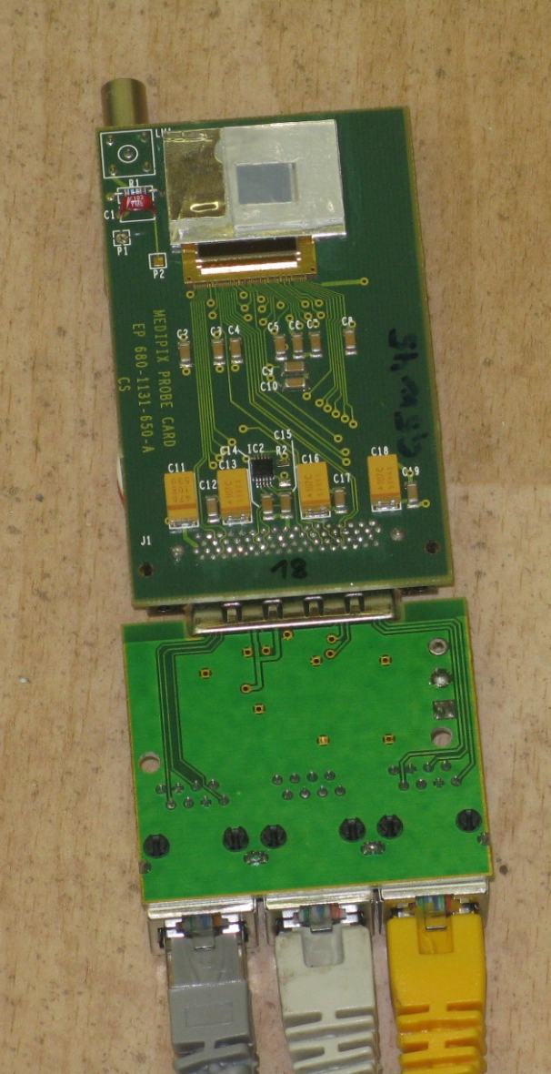
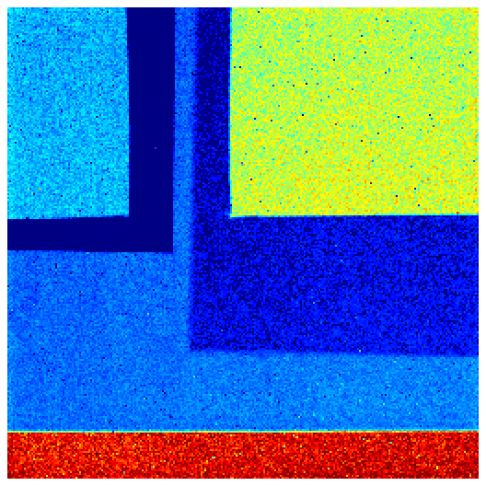
Neutron detection with MPX devices
Medipix 2 ASIC with 300µm Silicon layer
  256 x 256 pixel with 55µm pixel pitch
  Converter foils:
  ⁶Li(n,α)³H -> thermal neutrons
  PE: recoiled protons -> fast neutrons
LiF
PE
PE + Al
Al
Uncovered
Notes:
For uncharged particles like neutrons it is a bit more difficult.
So this is a typical device we use for neutron detection: This is a Medipix 2 ASIC with a 300 mum Silicon layer. It consists of 256x256 pixel
Active area 2 qcm.
As the neutrons have no charge they are detected indirectly. So neutron converter foils are glued on the surface of the silicon layer
Al support for this structure
There are also reactions of neutrons above a given threshold in the Silicon uncovered area.
Maybe a slide why we choose this LiF not other converters?
Threshold Si Reaction 5MeV

Slide 27
Detection efficiencies
Efficiencies for non charged particles are reduced by the conversion efficiency to detectable charged particles and geometry factors to following:
        Charged particles (above 8 keV): 100%
        X-rays (10 keV): ~80%
        Gamma-rays (above 1 MeV): ~0.01%
        Thermal neutrons (energy < 1 eV): ~1%
        Fast neutrons (MeV range): ~0.5%
Device lifetime expectancy:
It is expected that the device will survive up to neutron fluences of about 10¹³ neutrons/cm² (tested up to 1.5x10¹² neutron/cm²).
Notes:
Now what is the detection efficiency for different particles especially neutrons?
Charged particles above the Threshold.
For the neutrons the efficiency strongly depends on the conversion efficiency.
As I will show:These detectors are integrated in hte ATLAS detector. So just for your interest. This devices are expected to stand neutron fluences up to 10^13 /cm^2. With strong neutron sources this was confirmed up to 10^12

Slide 28
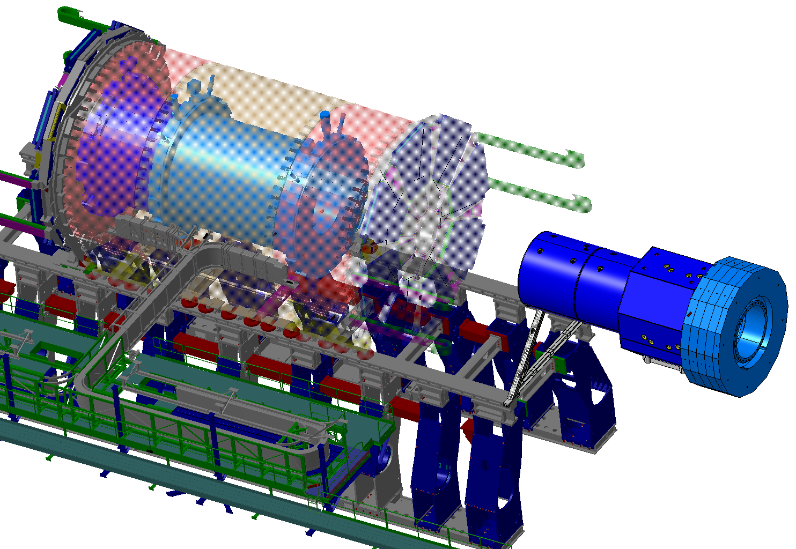
ATLAS – current MPX detector network
MPX01 | between ID and JM plug
MPX02 | between ID, LARG and JM
MPX03 | between LARG and LARG EC
MPX04 | between FCAL and JT
MPX05 | between LARG and JT wheel
MPX06 | between LARG and JT wheel
MPX07 | top of TILECAL barrel
MPX08 | top of TILECAL EXT. barrel
MPX09 | corner between JF cyl. and hexagon
MPX10 | cavern wall A or C side
MPX11 | cavern wall USA side
MPX12 | small wheel
MPX13 | between ID and JM plug
MPX14 | between ID, LARG and JM
MPX15 | at the back of Lucid detector
MPX16 | ATLAS-MPX rack in USA15
M14
M1
M7
M3
M13
M9
M4
M2
M5
M8
M6
M12
M15
M10
M11
Side A
Notes:
Now here is an overview over the positions of the MPX detectors in the ATLAS detecter. 16 devices are currently installed and taking data.

Slide 29
Institutes and people working on this project
Institute for Experimental and Applied Physics at Czech Technical University in Prague (IEAP CTU)
Stanislav Pospisil
Jan Jakubek
Michal Suk
Andrè Sopczak
Zdenek Vykydal
Daniel Turecek
Jaroslav Solc
Bartolomej Biskup
Vìt Sopko
Benedikt Bergmann
Université de Montrèal, Canada
Claude Leroy
Paul Soueid
Nedaah Asbah
Notes:
The institutes working in this MPX project are CTU ad University of Montreal. So this is not that big than one might think. There are just around 13 peoplne working on this project. And not for all of them this project is the main interest.

Slide 30
Proposed Atlas upgrade from mpx to tpx devices 2013 - 2014
Usage of the Timepix chip
    Per pixel energy deposition measurement (TOT)
        Particle identification using dE/dx information
        Better selectivity with the pattern recognition algorithm (see next slides)
    Time of arrival of the particles (TOA)
Faster readout electronics
  Reduce dead-time caused by device read-out by factor 50 (from 0.17 fps with one detector to 10 fps with two detectors (20 MHz readout frequency)
  Simplification of cabling – from 5 cables per device to 1 cable (one serial link + power)
  Possibility of trigger signal in USA15 to run the whole or part of the network in coincidence
Notes:
In 2013 there will be a LHC shut down for 2 years. We want to use this time with no collisions to do an Upgrade of this detector network.
Few reasons: - The technology goes on.. There are better devices and better readouts available. Not all of the current devices are still working properly.
For this upgrade it is proposed to to use TPX
Another thing is that we will use a newer readout which will reduce the dead time by a factor of 50.
This readout also just needs one cable instead of 3, which is a real advantage. In the current network 7.5 km of cabling were needed.
We want to have the possibility to use a common trigger signal to have all devices work in coincidence and maybe do some TOF measurements of particles coming from the vertex that are seen in different devices .. But that is for the moment just a rough idea

Slide 31
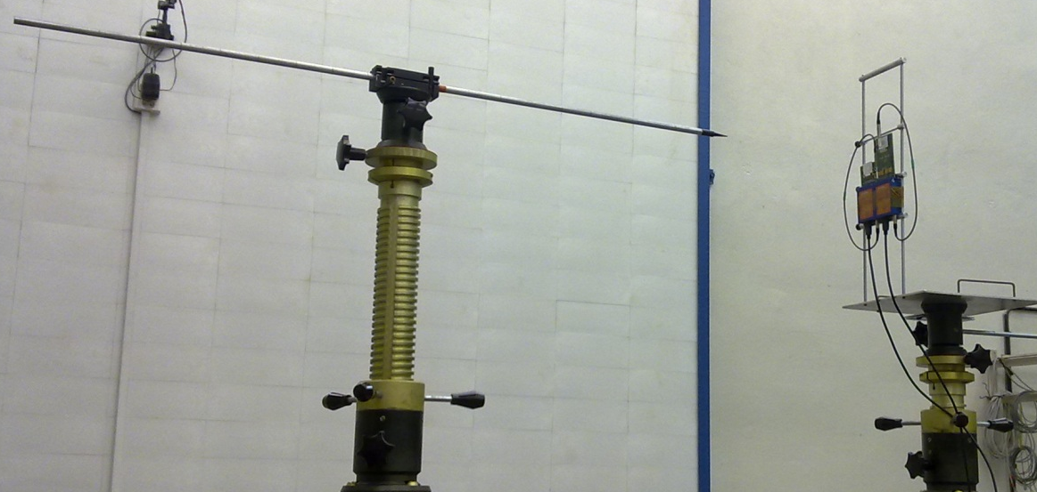
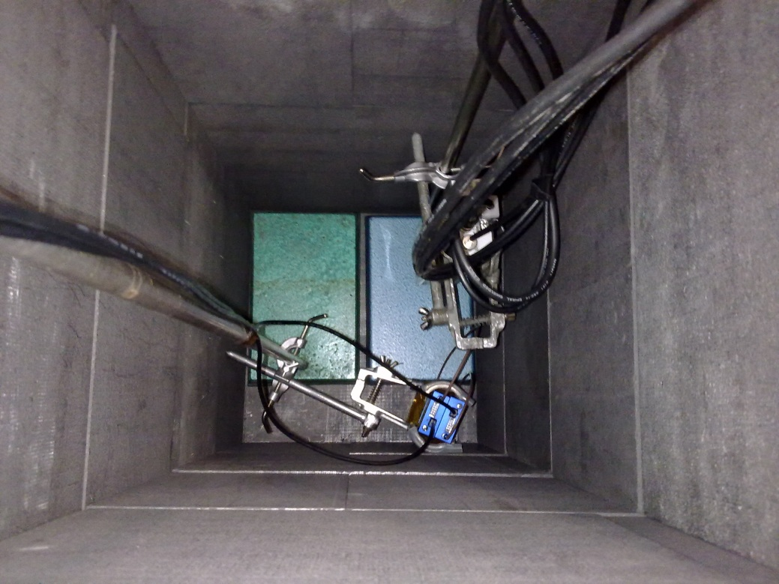
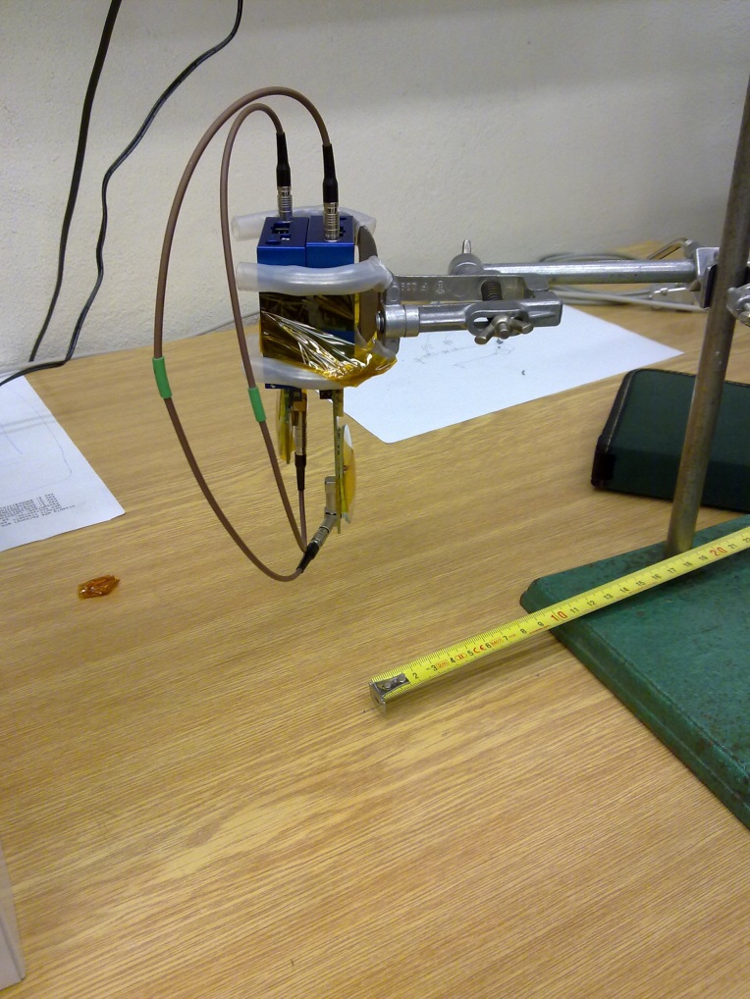
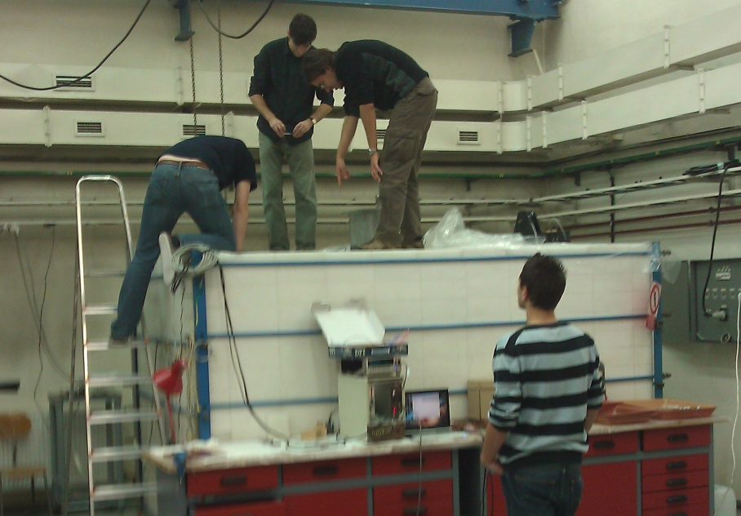
Measurement at Czech Metrological Institute
fast neutron measurement
Upgrade from MPX to TPX
Comparison of response of MPX and TPX to thermal neutron and fast neutron impact (Cf, AmBe)
Calibrate TPX
thermal neutron measurement
Notes:
Concerning this Upgrade we performed a measurement at the CMI. This was done for two reasons: Compare the response of the different devices MPX an TPX to different neutron fields. These fields are Thermal neutrons, fast neutrons coming from an AmBe source and fn from an Cf 252 source. This data is also needed to calibrate the TPX device.

Slide 32
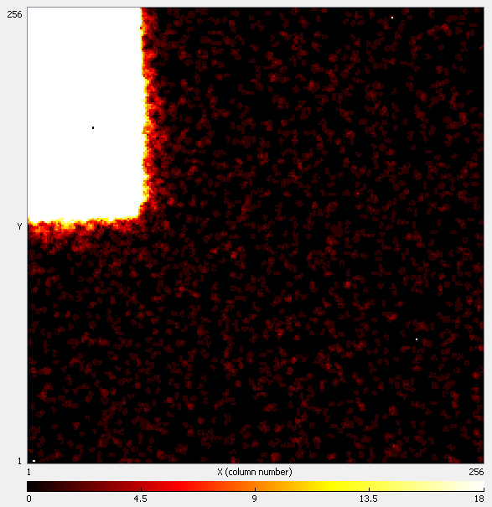
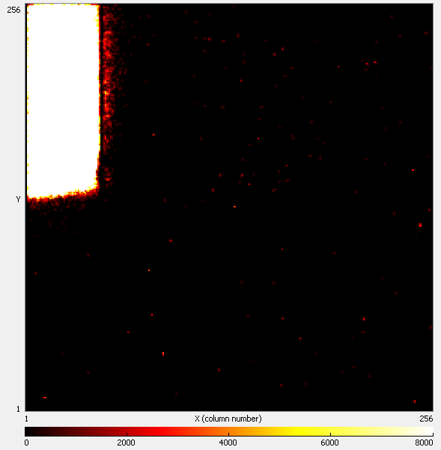
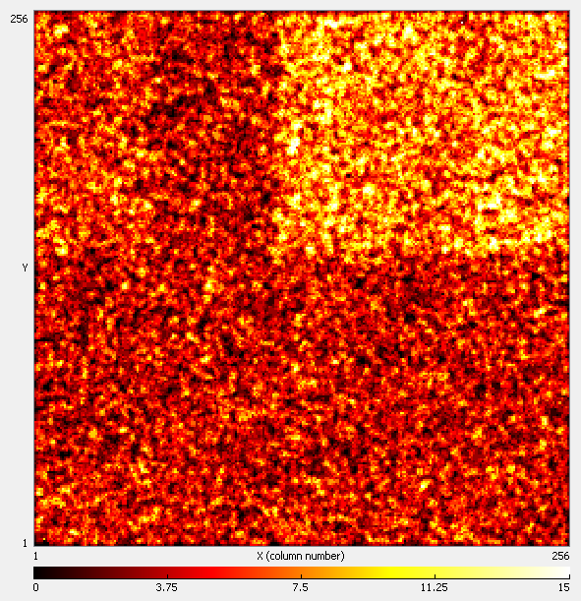
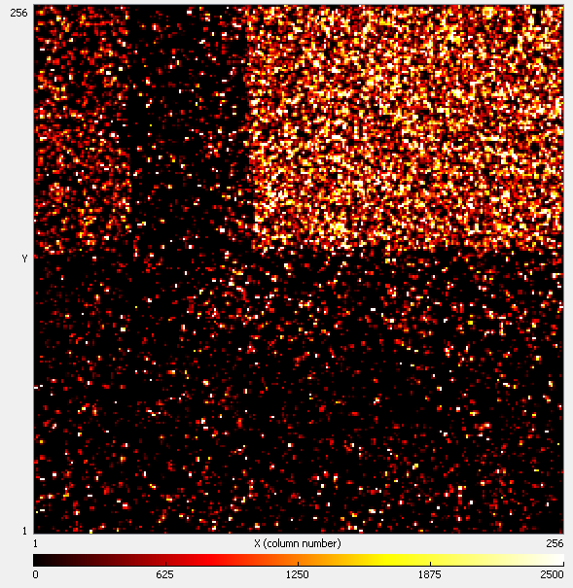
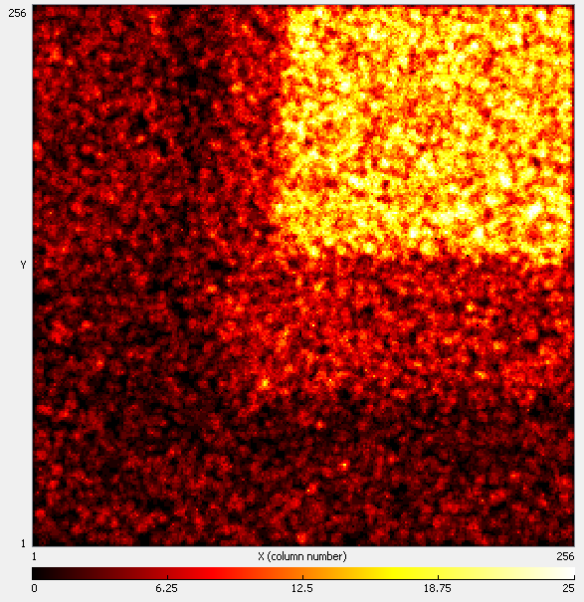
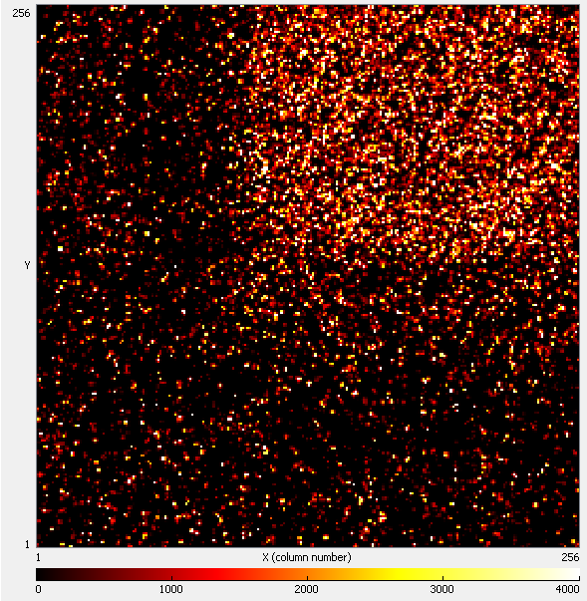
comparison: MPX vs. TPX
²⁵²Cf (E_{mean} = 2 MeV)
MPX
TPX
thermal neutrons (E < 0.5eV)
MPX
TPX
MPX
TPX
AmBe (E_{mean} = 4 MeV)
Notes:
Here are the results of this measurement. The responses of the MPX and TPX detector to the different neutron fields.
Threshold for reaction in silicon?

Slide 33
Measured energy spectrum for the Thermal neutron Measurement – only TPX
Consists of Tritium and α-Peak smeared out due to different interaction depths in the convertor
Criteria used (pattern recognition algorithm):
  Minimum cluster size: 8 pixel
  Minimum cluster height: 100 keV
  Minimum cluster roundness: 0.76
N_{selected} = 97799
N_{all} = 618657
selected clusters only
all clusters

Slide 34
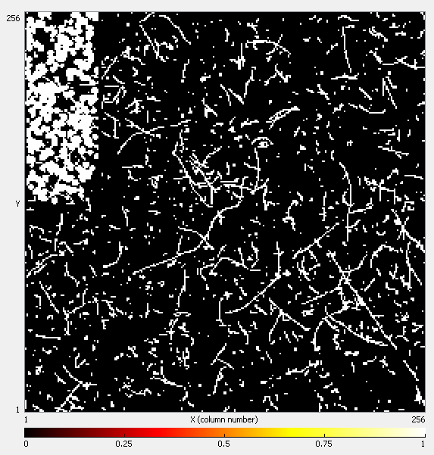
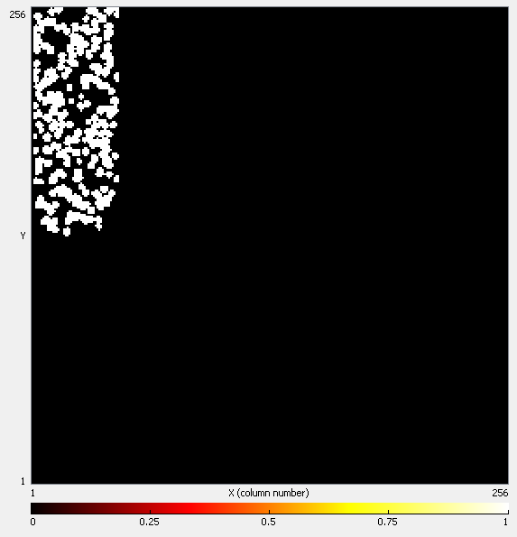
TPX: The power of Pattern Recognition – Thermal Neutrons
50 frames with acquisition time 0.1s in a nearly isotropic thermal neutron field
Integrated picture of raw data
Integrated picture of selected events
Notes:
Now what is behind this pictures? – This is the TPX as an example.

Slide 35
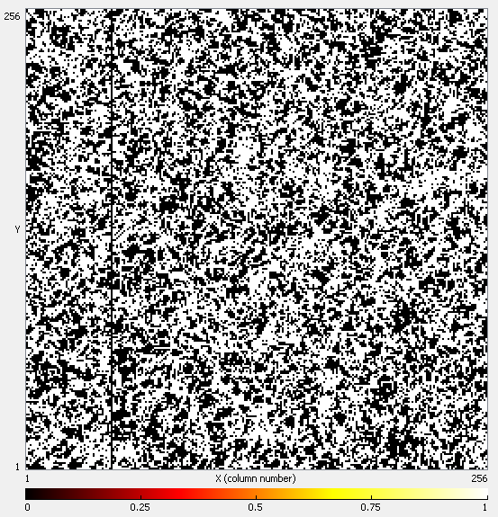
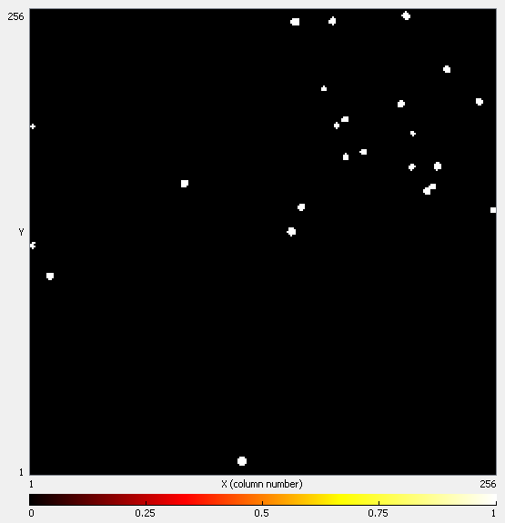
TPX: The power of Pattern Recognition – Fast Neutrons
70 frames with acquisition time 0.1s in neutron field of ²⁵²Cf source
Integrated picture of raw data
Integrated picture of selected events

Slide 36
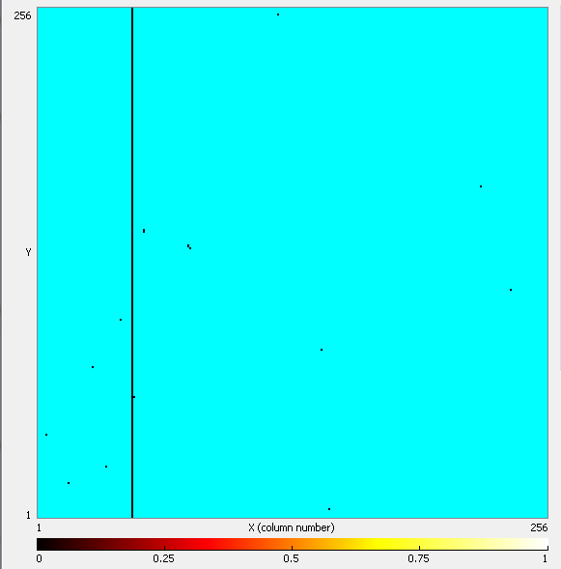
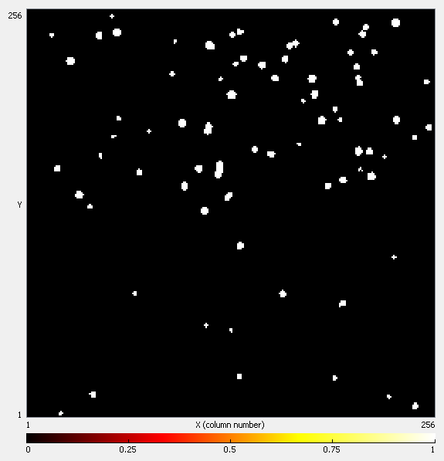
TPX: The power of Pattern Recognition – Fast Neutrons
1000 frames with acquisition time 0.04s in neutron field of AmBe source
Mean counts per pixel: 264!
Integrated picture of raw data
Integrated picture of selected events

Slide 37
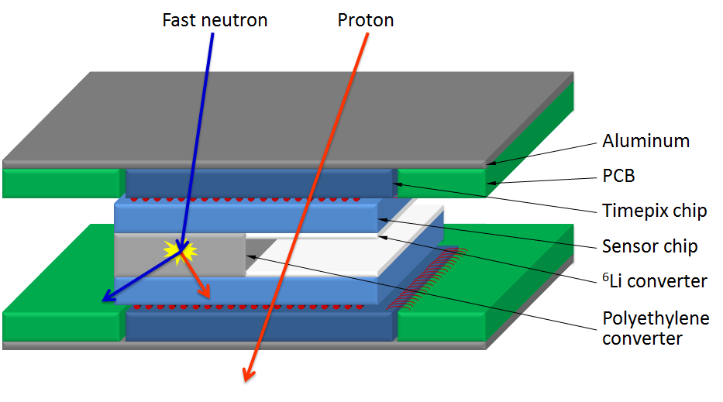
From single Devices to Hodoscopes
Two layer face-to-face structure
  Better particle identification (anticoincidence between detectors)
  Directional sensitivity
Neutron converters in between
  4 regions? – LiF, PE1, PE2, uncovered
500 µm thick silicon
  Bias voltage < 100 V
Notes:
This was all data with a single device. For the upgrade it is planned to use so called hodoscopes.
Aluminum for cooling of the devices; Activated Al short half life time
Design of the regions not yet clear.
500 mum increase angular acceptance, fully depleted below 100V

Slide 38
Applications of mixed field data Acquisition and evaluation
From high energy physics to ….
… dosimetric applications
      Space (NASA, ESA)
      Airplanes
      Accelerators (LHC, etc.)
      Cancer treatment with Proton or Carbon Ion beam
        …
Notes:
The last slide is to show you that this is not only useful in high energy physic but has different apllications..here is also the connection to the aim of the ARDENT project.
…. From high energy physics to dosimetric applications.
This technique is already used for dosimetry in space. On space stations and Satellites of the NASA and ESA these devices are installes and give an estimation of the current dose rates. Ohter applications are on airplanes, in Accelerators or in this Cancer treatment with Proton or Carbon Ions and probably many more…

Slide 39
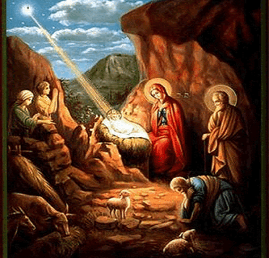
Merry X-mas
Thank you for your attention ….

